Slide 1

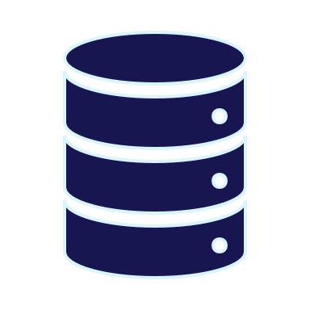

SSDT going multi-platform with SDK-style projects
By Eitan Blumin
Background by Dirk Wouters / Pixabay

Slide 2

Copyright © 2024 Madeira Ltd
All Rights Reserved
Full rights, including copyrights, belong exclusively to Madeira Ltd
No use of the materials, in any form, is allowed,
unless receiving a prior written permission from Madeira Ltd
Background by Dirk Wouters / Pixabay

Slide 3

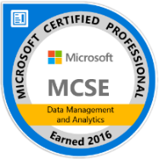



About Me…
Name: Eitan Blumin
Email: eitan@madeiradata.com
Blog: eitanblumin.com
Podcast: sqlserverradio.com | .co.il
Bluesky: eitanblumin.bsky.social
LinkedIn: linkedin.com/in/eitanblumin
MadeiraData.com
Notes:
Q: How to reach me?
Q: Where to find more resources? (blog)

Slide 4
SQL Server Data Tools (SSDT)
Going Multi-Platform with SDK-style projects
What is this about?
Who is it for?
Notes:
Refer to series:
https://www.eitanblumin.com/cicd
Refer to existing familiarity with SSDT, multi-platform, and CICD requirements

Slide 5

Agenda
What is SSDT (classic)?
What is SSDT (SDK-style)?
Installing SSDT SDK-style
Features Showcase
Tools Comparison
Notes:
Q: What questions will we answer in this presentation?

Slide 6

What is SSDT? (Recap)
Available for Free from Microsoft
Set of tools and project types for Microsoft Visual Studio, VS Code, and Azure Data Studio.
SQL Database Project
BI Project Types (SSRS, SSIS, SSAS)
https://docs.microsoft.com/sql/ssdt/
Notes:
Q: What is SSDT?
Q: How is SSDT used? (VS)
Q: What is contained within SSDT?

Slide 7
SSDT (classic) Features: Recap
Creating Database Project using Import
Database Reference (user / system DB, same-DB / cross-DB / cross-server)
SQL CLR Development (same project)
SQL Server Object Explorer, SQL Query Editor
Refactor Tool
  Rename
  Move to Schema
  Fully-Qualify Names
  Expand Wildcards (*)
Unit Tests
Schema and Data Compare
Publish Profiles and SQLCMD variables
https://learn.microsoft.com/sql/ssdt/project-oriented-offline-database-development
Notes:
Q: What have we covered?
Q: What else is there? (CLR, BI Projects)

Slide 8
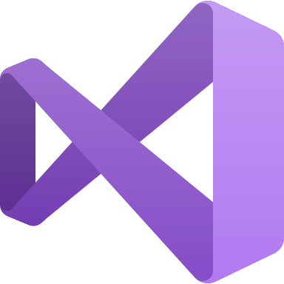
What is SSDT (classic)
Microsoft Visual Studio (Windows-only)
.NET Framework backbone (Windows-only)
MSBuild.exe (Windows-only)
.sqlproj explicitly specifying files to include in project
Deployment of .dacpac using SqlPackage.exe / DacServices

Slide 9
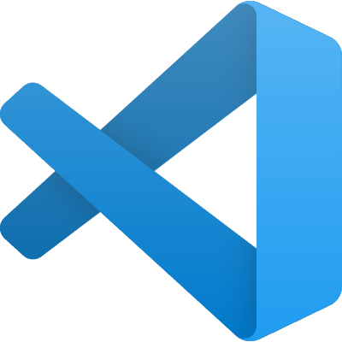

What is SSDT (SDK-style)
VS Code and Azure Data Studio (multi-platform)
.NET Core backbone (multi-platform)
dotnet build (multi-platform)
.sqlproj implicitly including files in project via “globbing”
Deployment of .dacpac using SqlPackage.exe

Slide 10
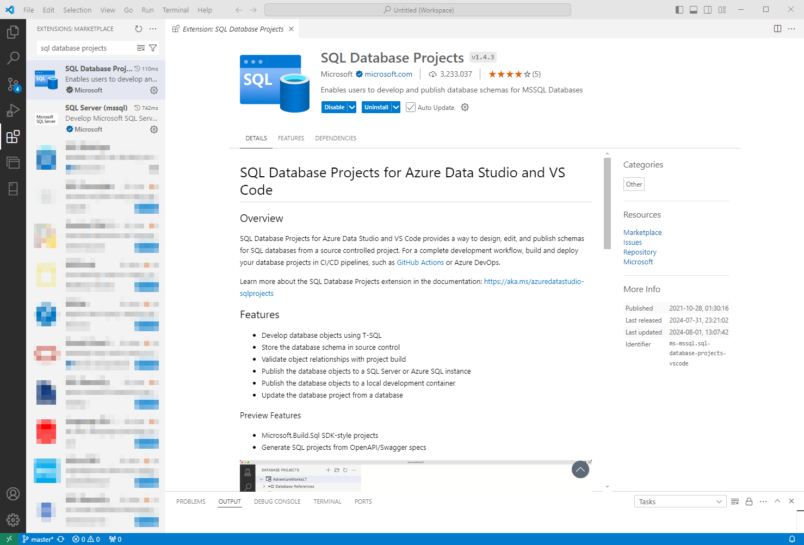
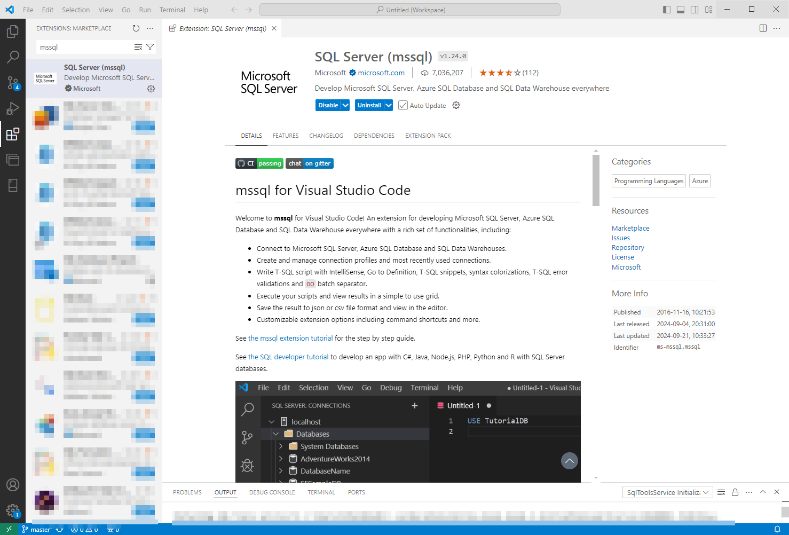
Installing VS Code extensions
https://marketplace.visualstudio.com/items?itemName=ms-mssql.sql-database-projects-vscode

Slide 11
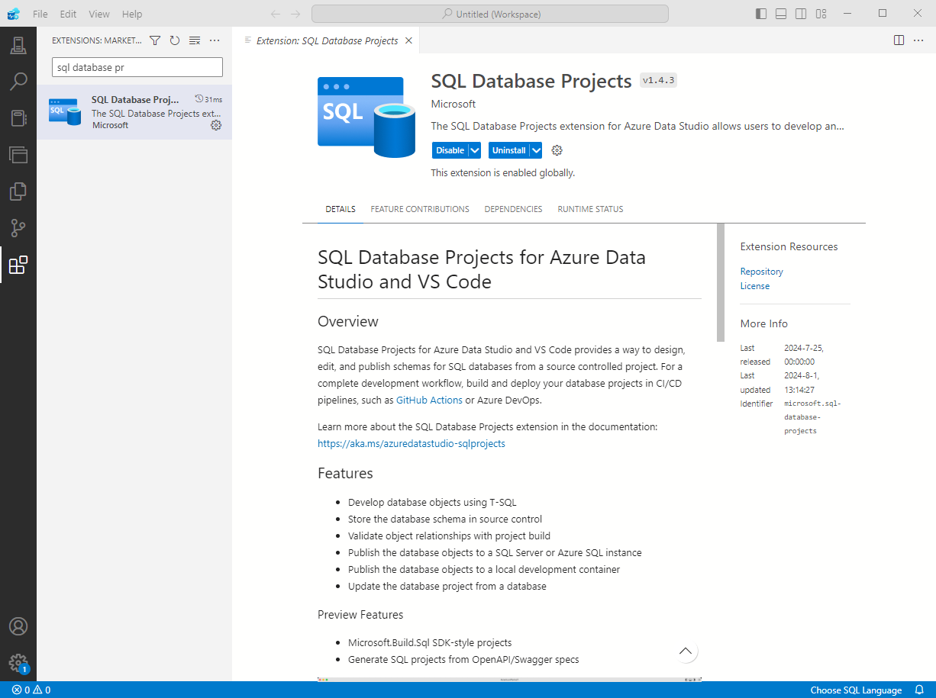
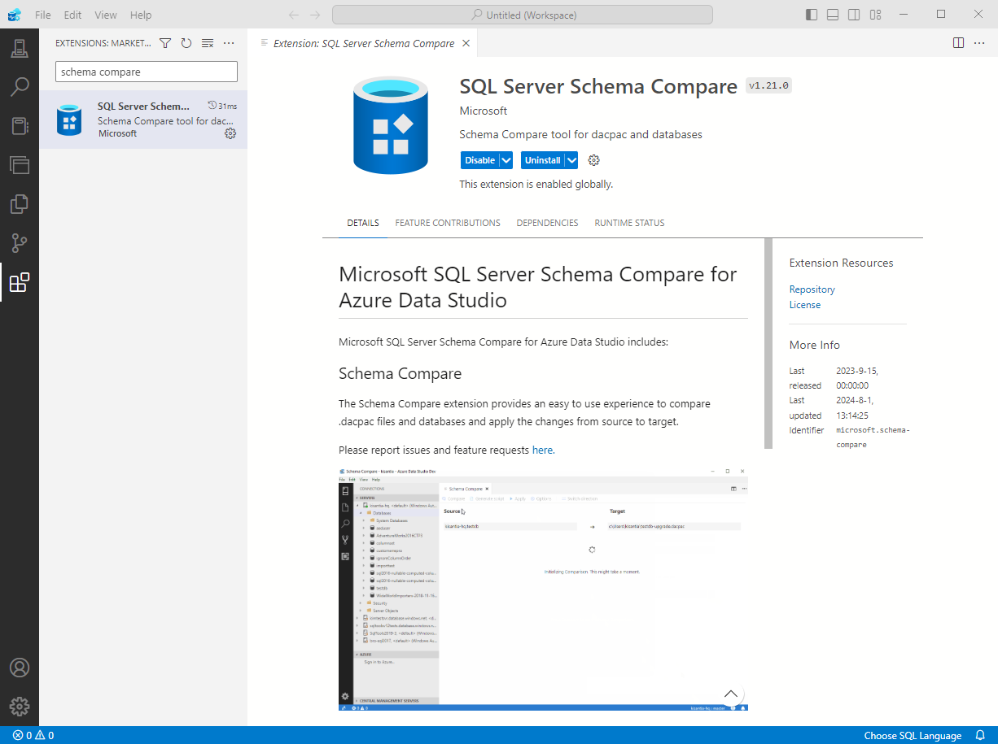
Azure Data Studio extensions
DEPRECATED
learn.microsoft.com/sql/azure-data-studio/extensions/sql-database-project-extension
Notes:
https://devblogs.microsoft.com/azure-sql/azure-data-studio-retirement/

Slide 12
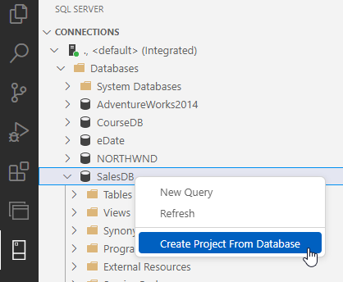
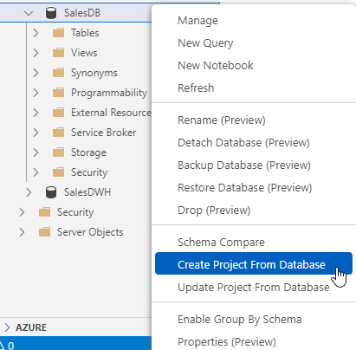
Create Database Project
DEPRECATED
Notes:
Q: How to create your first SSDT project?
Q: What are possible sources for database import?
(this is a replacement slide for a live demo)

Slide 13
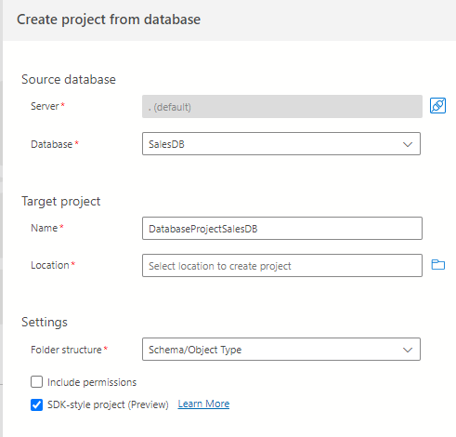
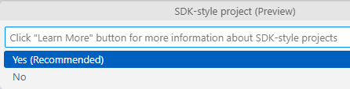
Create Database Project
DEPRECATED
Notes:
Q: How to create your first SSDT project?
Q: What are possible sources for database import?
(this is a replacement slide for a live demo)

Slide 14
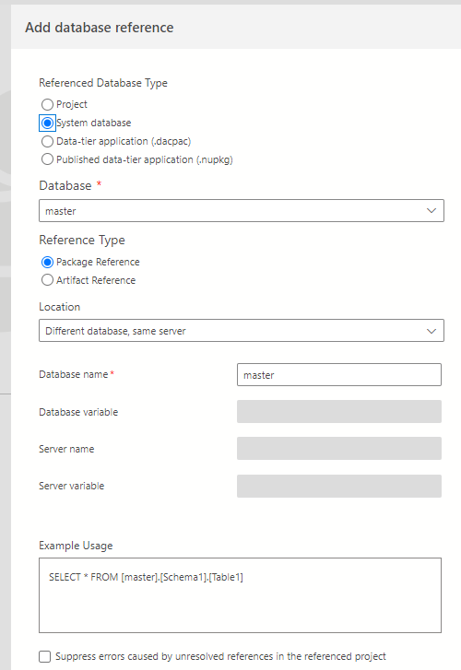
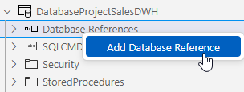
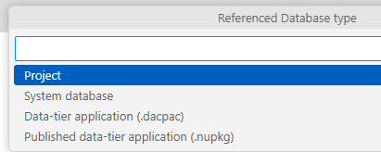
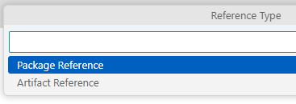
Database Reference
DB Sources:
Project, SystemDB (Package / Artifact), dacpac, Nuget
DB Locations
SQLCMD Variables
Error Suppression
DEPRECATED
Notes:
Q: What are possible database reference sources? (projects, system database, dacpac, nuget package)
Q: What are possible database locations? (same database same server, different database same server, different database different server)
Q: What’s the difference between Package Reference and Artifact Reference?
Q: How are SQLCMD Variables utilized in database references?
Q: Why suppress or not to suppress unresolved reference errors?
(this is a replacement slide for a live demo)

Slide 15
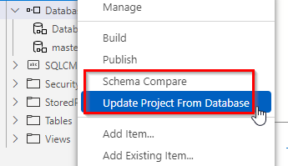
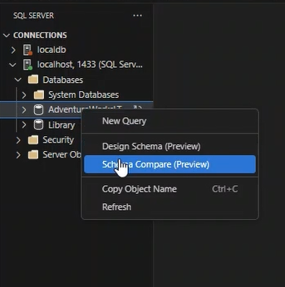
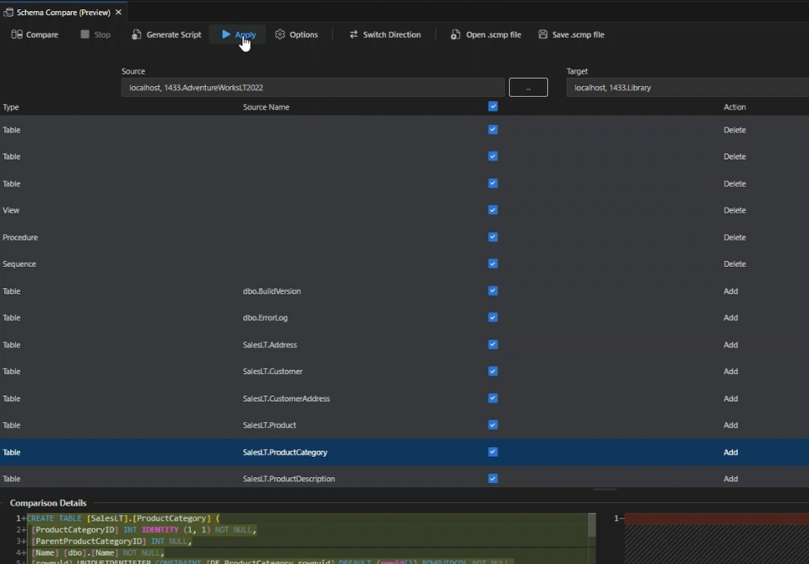
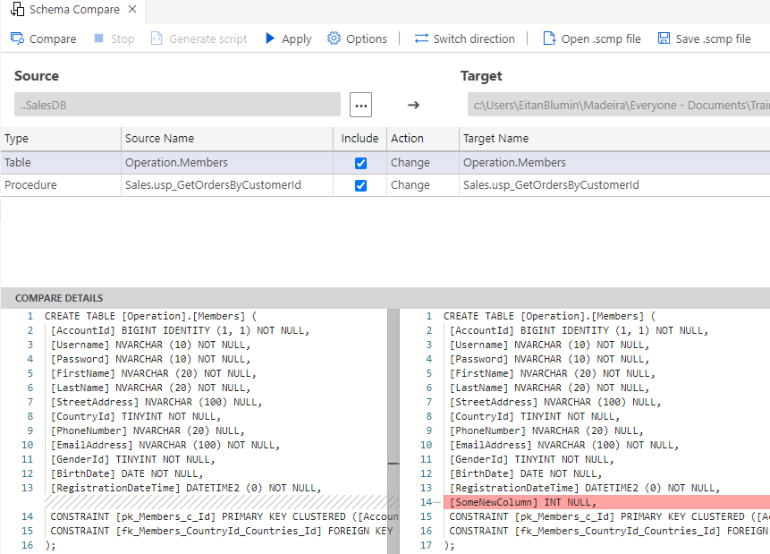
Schema Compare
DEPRECATED
Notes:
In preview in VS Code
https://devblogs.microsoft.com/azure-sql/vscode-mssql-schema-compare/
Q: How to perform Schema Compare in SSDT?
Q: What kind of options and settings can we control?
Q: What kind of sources and targets can we use for comparison? (project, database, dacpac)
(this is a replacement slide for a live demo)

Slide 16
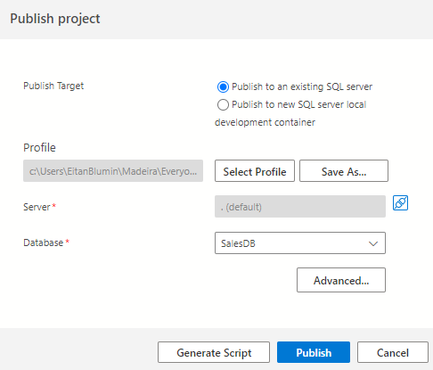
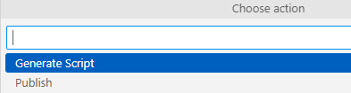
Publish Database
DEPRECATED
Publish | Generate Script
Publish Profiles
Publish to local dev container*
Notes:
Q: How to publish a database?
Q: What kind of options and settings can we use?
Q: What are Publish Profiles?
Q: What does it mean to register as a Data-tier Application?
(this is a replacement slide for a live demo)

Slide 17
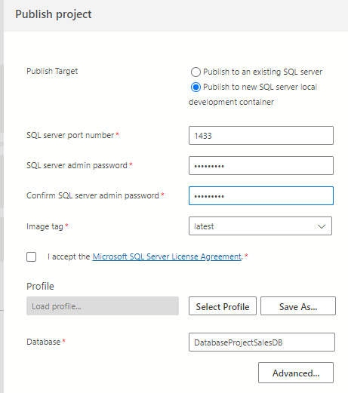
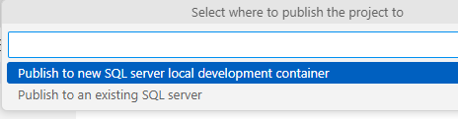
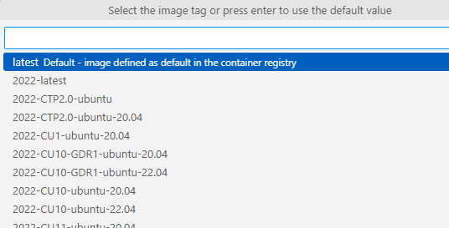
Publish Database to local dev container
DEPRECATED
*Requires Docker installed
Notes:
Requires Docker installed

Slide 18
SSDT Features: ADS/VS Code Parity
Creating Database Project using Import
Database Reference (user / systemDB / Nuget, same-DB / cross-DB / cross-server)
SQL CLR Development (same project)
SQL Server Object Explorer, SQL Query Editor
Refactor Tool
  Rename
  Move to Schema
  Fully-Qualify Names
  Expand Wildcards (*)
Unit Tests
Schema and Data Compare (Schema only)
Publish Profiles and SQLCMD variables
DEPRECATED
Notes:
Q: What have we covered?
Q: What else is there? (CLR, BI Projects)

Slide 19
SSDT Feature Support Differences
Visual Studio
Import Database Schema to Project
✅ Schema and Data Compare
Azure Data Studio
Create / Update Project from Database
✅❌ Schema Compare
VS Code
✅ dotnet build
✅❌ Schema Compare
✅ Refactor Tool
❌ No Refactor Tool
❌ No Refactor Tool
✅ Project / Artifact / Package Reference
✅❌ Project / Artifact Reference
✅ Project / Artifact / Package Reference
✅ Unit Testing
❌ No Unit Testing
❌ No Unit Testing
✅ CLR Integration
❌ No CLR Integration
❌ No CLR Integration
❌ MSBuild (Windows only)
✅ dotnet build
Create Project from Database
✅ Easy-to-use UI
✅ Easy-to-use UI
❌ No easy-to-use UI
DEPRECATED

Slide 20

Classic SSDT? Or SDK-Style?

Slide 21

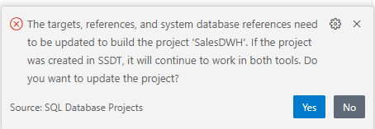
Why not both?
Create in Visual Studio
(SSDT classic)
Open and Update in ADS/VSCode
🎉 Supports both MSBUILD and DOTNET BUILD 🎉
(not all features, though)
(Refactor tool works!)
Notes:
The project will be possible to open in both tool types and support both build types, but feature parity is still incomplete
(namely CLR and unit tests)

Slide 22

THERE IS ANOTHER

Slide 23
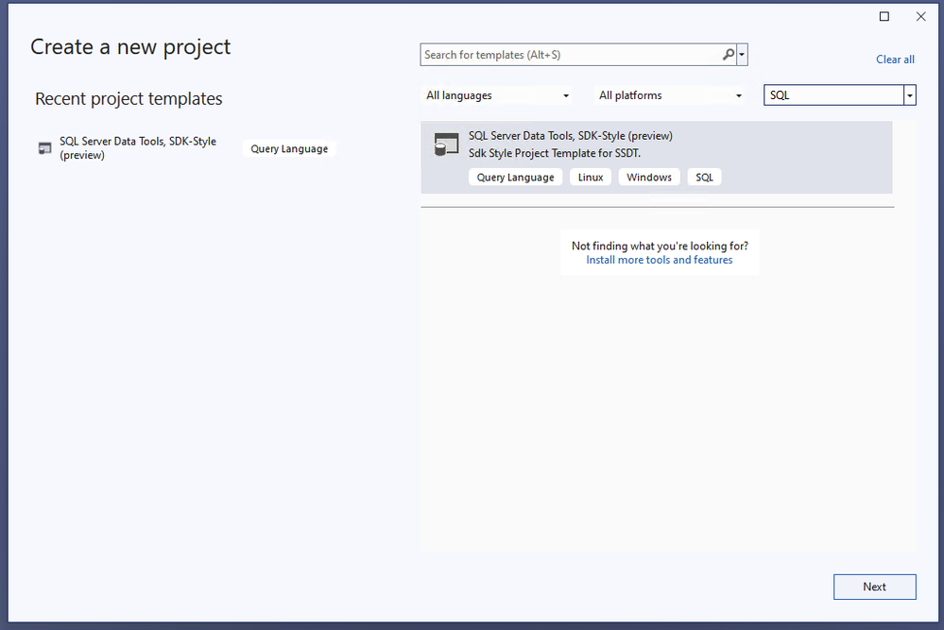
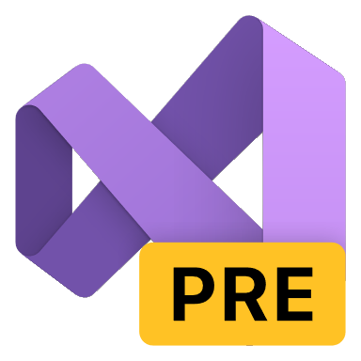
What does the FUTURE hold?
Visual Studio 2022 starting with version 17.12-preview-2 with SDK-style SQL projects based on Microsoft.Build.Sql 0.2.0-preview
NOT compatible to be installed in VS alongside SSDT side-by-side
.sqlprojx extension
Very bare-bones, barely functional
Not supported in ADS/VSCode
*as of 2024

Slide 24
Additional Resources
Microsoft.Build.Sql: the next frontier of SQL projects
What are SQL database projects?
Preview release of SDK-style SQL projects in Visual Studio 2022
Azure Data Studio Retirement - Azure SQL Devs’ Corner
Notes:
https://techcommunity.microsoft.com/t5/azure-sql-blog/microsoft-build-sql-the-next-frontier-of-sql-projects/ba-p/3290628
https://learn.microsoft.com/en-us/sql/tools/sql-database-projects/sql-database-projects?view=sql-server-ver16
https://techcommunity.microsoft.com/t5/azure-sql-blog/preview-release-of-sdk-style-sql-projects-in-visual-studio-2022/ba-p/4240616
https://devblogs.microsoft.com/azure-sql/azure-data-studio-retirement/

Slide 25

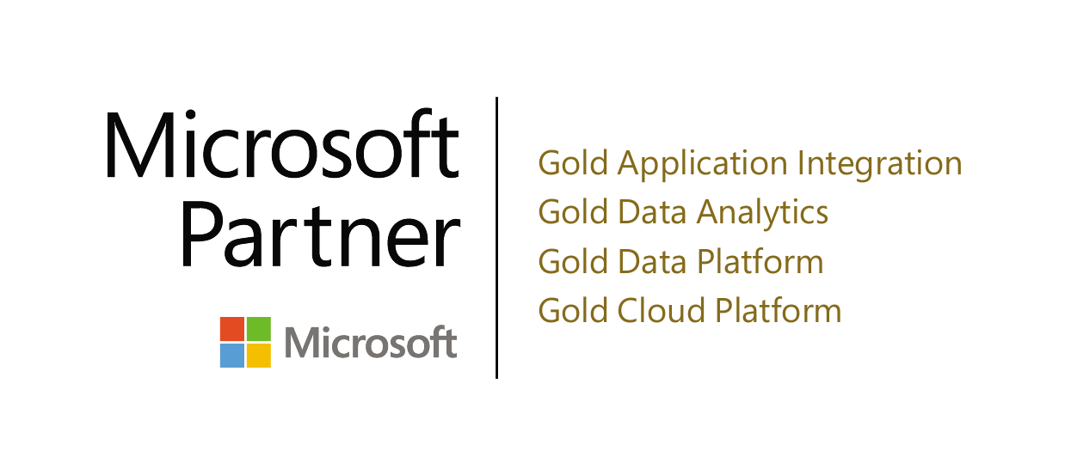
Thank you! (Time for questions)
Name: Eitan Blumin
Email: eitan@madeiradata.com
Blog: eitanblumin.com
Podcast: sqlserverradio.com | .co.il
Bluesky: eitanblumin.bsky.social
LinkedIn: linkedin.com/in/eitanblumin
GitHub: github.com/MadeiraData
madeiradata.com

