Slide 1
SSDT Tools and Features for SQL Server DevOps
By Eitan Blumin
Background by Dirk Wouters / Pixabay

Slide 2
Copyright © 2023 Madeira Ltd
All Rights Reserved
Full rights, including copyrights, belong exclusively to Madeira Ltd
No use of the materials, in any form, is allowed,
unless receiving a prior written permission from Madeira Ltd
Background by Dirk Wouters / Pixabay

Slide 3
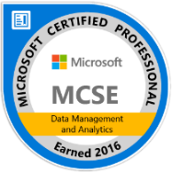
About Me…
Name: Eitan Blumin
Email: eitan@madeiradata.com
Blog: eitanblumin.com
Podcast: sqlserverradio.com | .co.il
Bluesky: eitanblumin.bsky.social
LinkedIn: linkedin.com/in/eitanblumin
MadeiraData.com
Notes:
Q: How to reach me?
Q: Where to find more resources? (blog)

Slide 4
SQL Server Data Tools (SSDT) Tools and Features for SQL Server DevOps
What is this about?
Who is it for?
Notes:
Refer to part 1: Development Lifecycle Basics for DBAs as prerequisite
Part 2: SSDT Methodologies for SQL Server DevOps

Slide 5
What is SQL Server Data Tools?
Available for Free from Microsoft
Set of tools and project types for Microsoft Visual Studio, VS Code, and Azure Data Studio.
Combination of Extensions and Add-Ons
SQL Database Project
BI Project Types (SSRS, SSIS, SSAS)
Utilities:
Schema and Data Compare
Refactoring
Unit Testing
https://docs.microsoft.com/sql/ssdt/
Notes:
Q: What is SSDT?
Q: How is SSDT used? (VS)
Q: What is contained within SSDT?

Slide 6
What is SQL Server Data Tools?
Build command:
MSBuild.exe (for classic SSDT, Windows-only)
dotnet build (for SDK-style SSDT, multi-platform)
Project artifact:
.dacpac
Deployment command:
SqlPackage.exe
Powershell (DacServices / DbaTools)
Unit test project type:
MSTest
Unit test execution:
VSTest.Console.exe
https://docs.microsoft.com/sql/ssdt/
Notes:
Q: What is SSDT?
Q: How is SSDT used? (VS)
Q: What is contained within SSDT?

Slide 7
Installing SSDT (Tools and Features)
Tools > Get Tools and Features…
https://learn.microsoft.com/sql/ssdt/
Notes:
Q: How to install SSDT’s SQL Project? (Tools > Get Tools and Features…)
Q: What does the SSDT extension contain?

Slide 8
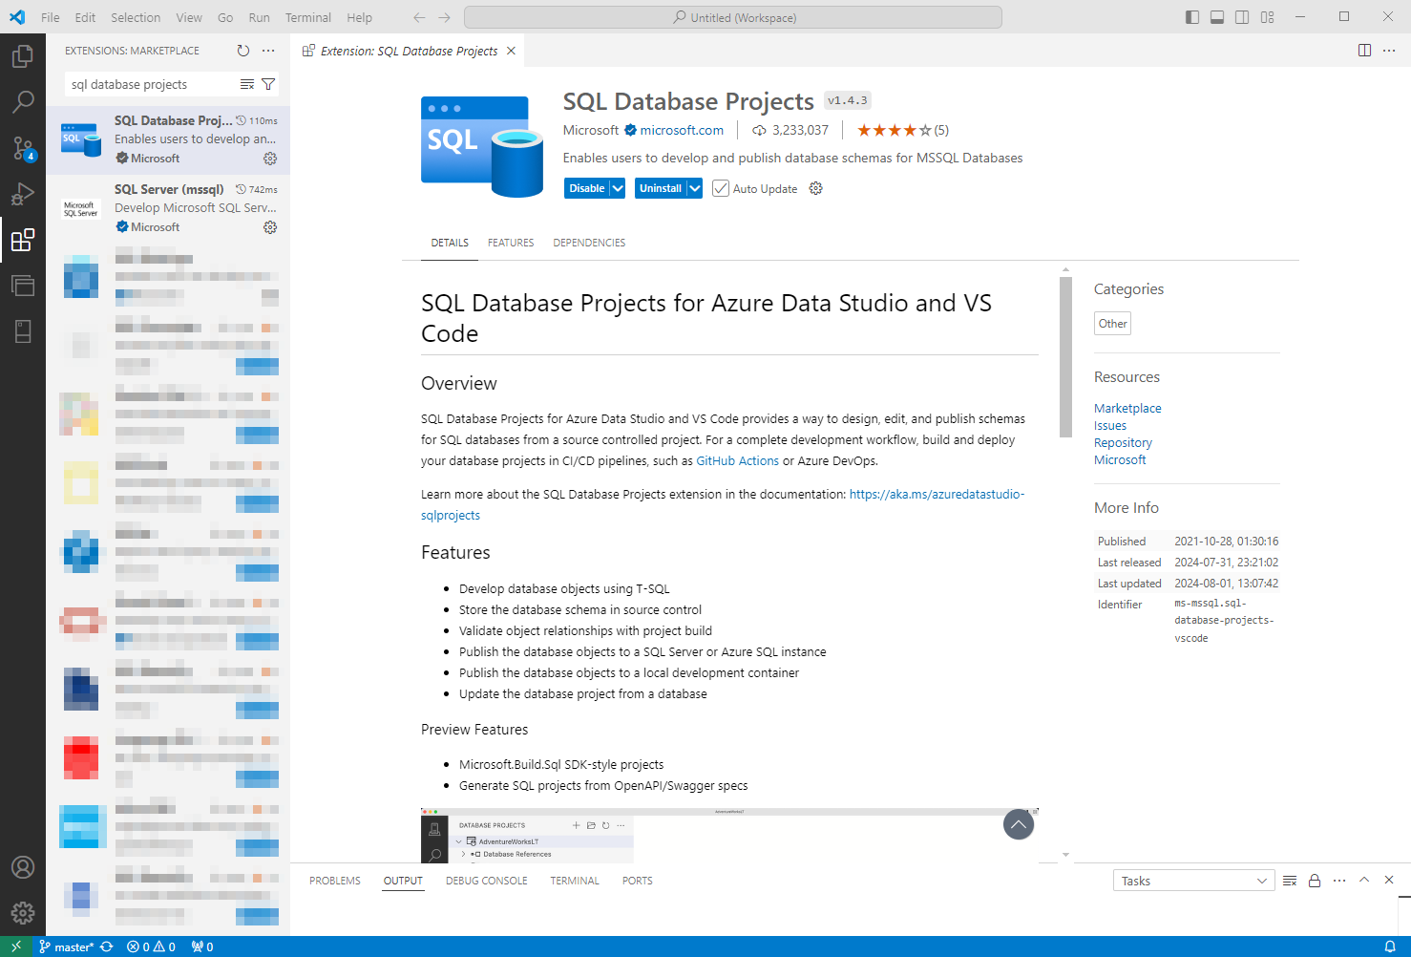
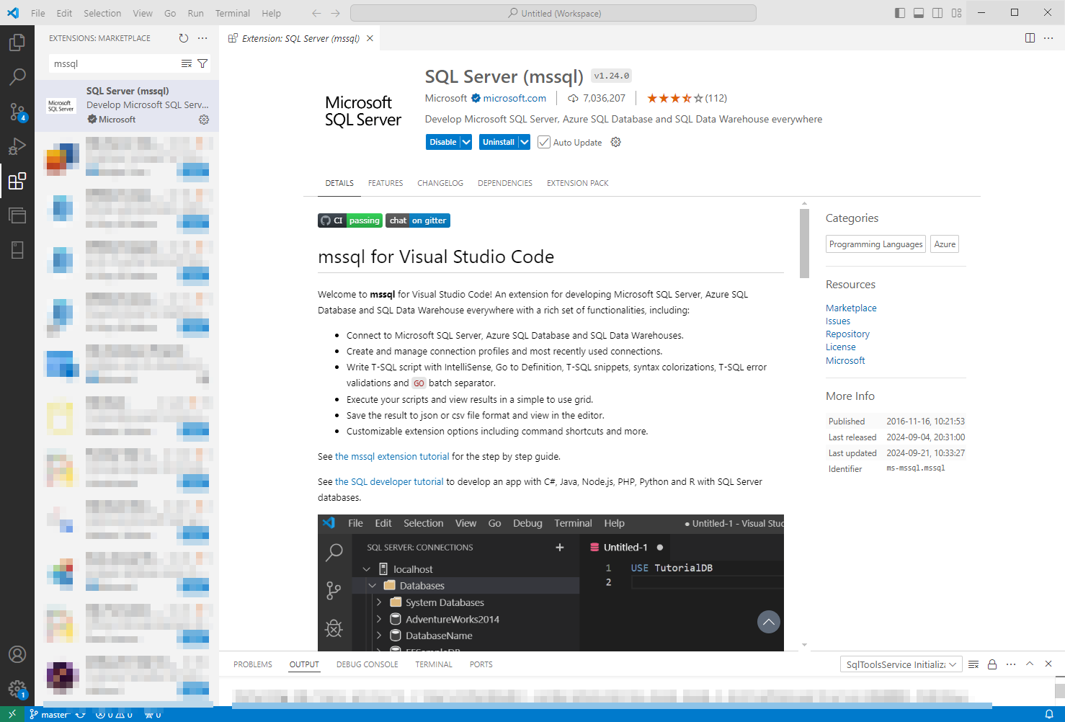
VS Code extensions
https://marketplace.visualstudio.com/items?itemName=ms-mssql.sql-database-projects-vscode

Slide 9
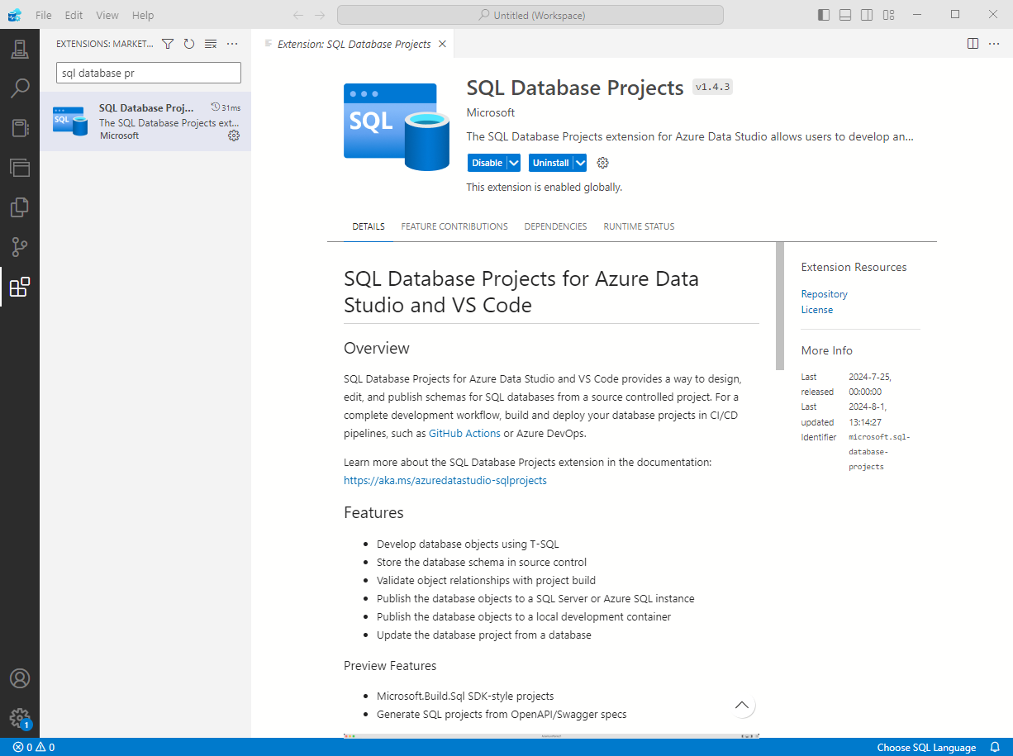
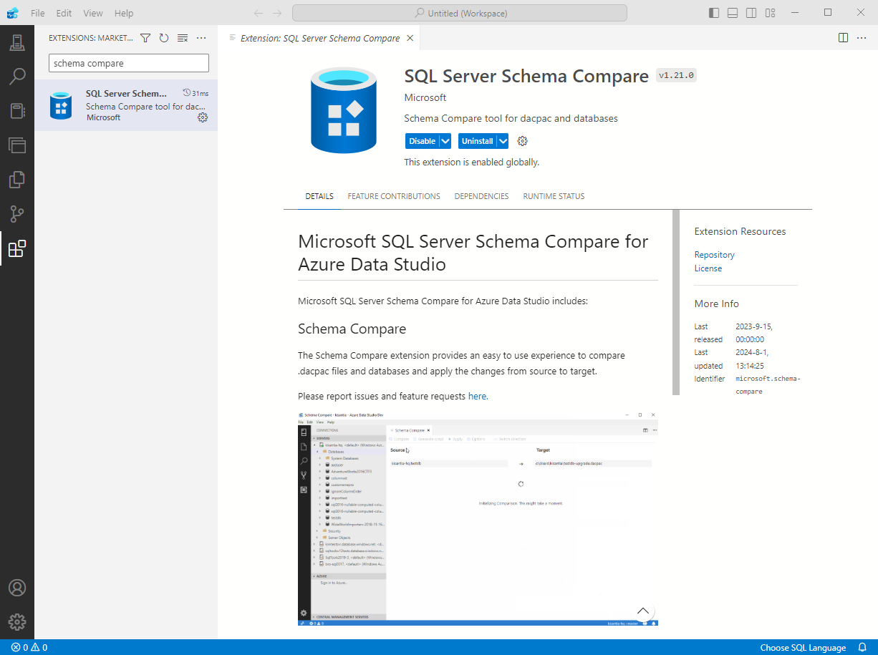
Azure Data Studio extensions
learn.microsoft.com/sql/azure-data-studio/extensions/sql-database-project-extension

Slide 10
SSDT Concepts: Recap
Project = Database
Each Object = SQL Script File
Schema Only, No Data
Deployment Artifact: DACPAC File
Design-Time Compiler Service
Publish Script Format: SQLCMD
Notes:
Recap

Slide 11
Demo

Slide 12
SSDT Features & Tools
Creating Database Project using Import
Database Reference (user / system DB, same-DB / cross-DB / cross-server)
SQL CLR Development (same project)
SQL Server Object Explorer, SQL Query Editor
Refactor Tool
Rename
Move to Schema
Fully-Qualify Names
Expand Wildcards (*)
Unit Tests
Schema and Data Compare
Publish Profiles
https://learn.microsoft.com/sql/ssdt/project-oriented-offline-database-development

Slide 13
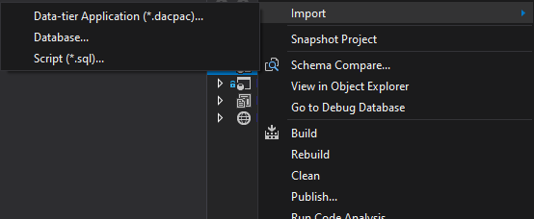
Import Database Project
Notes:
Q: How to create your first SSDT project?
Q: What are possible sources for database import?
(this is a replacement slide for a live demo)

Slide 14
Database Reference
DB Sources: sqlproj, master/msdb,dacpac
DB Locations
SQLCMD Variables
Error Suppression
Notes:
Q: What are possible database reference sources? (projects, system database, dacpac)
Q: What are possible database locations? (same database same server, different database same server, different database different server)
Q: How are SQLCMD Variables utilized in database references?
Q: Why suppress or not to suppress unresolved reference errors?
(this is a replacement slide for a live demo)

Slide 15
CLR Development & Reference
Aggregates
Procedures
Triggers
Functions
Types
Notes:
SQL CLR objects can also be created within the project
(this is a replacement slide for a live demo)

Slide 16
SQL Server Query Editor
Connects to live databases
SSMS-Like
Keyboard shortcuts are a bit different
Notes:
Q: What is the SQL Server Query Editor in SSDT?
Q: What can it be used for?
(this is a replacement slide for a live demo)

Slide 17
SQL Server Object Explorer
SSMS-Like
Unit Tests
Refactor Tool
Notes:
Q: What is the SQL Server Object Explorer in SSDT?
Q: What can it be used for?
(this is a replacement slide for a live demo)

Slide 18
Refactor Tool
Rename
Move to Schema
Fully-Qualify Names
Expand Wildcards (*)
Notes:
Q: What is the Refactor tool in SSDT?
Q: What can it be used for?
(this is a replacement slide for a live demo)
https://docs.microsoft.com/en-us/sql/ssdt/how-to-use-rename-and-refactoring-to-make-changes-to-your-database-objects?view=sql-server-ver15

Slide 19
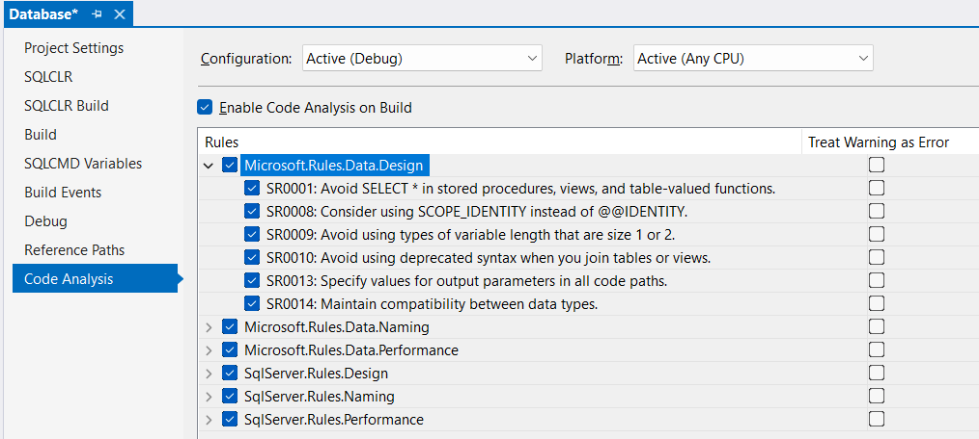
SQL Code Analysis
tcartwright/SqlServer.Rules
davebally/TSQL-Smells
How to: Code analyze your SQL Server T-SQL scripts in Visual Studio | ErikEJ's blog
Notes:
https://erikej.github.io/dacfx/codeanalysis/sqlserver/2024/04/02/dacfx-codeanalysis.html
https://github.com/tcartwright/SqlServer.Rules/tree/master
https://github.com/davebally/TSQL-Smells

Slide 20
Database Unit Testing
default
Notes:
Q: What are Unit Tests in SSDT?
Q: What kind of control do we have in those unit tests?
Q: What kind of test conditions can we use?
Read more: https://docs.microsoft.com/sql/ssdt/using-test-conditions-in-sql-server-unit-tests
(this is a replacement slide for a live demo)

Slide 21
Schema Compare
Notes:
Q: How to perform Schema Compare in SSDT?
Q: What kind of options and settings can we control?
Q: What kind of sources and targets can we use for comparison? (project, database, dacpac)
(this is a replacement slide for a live demo)

Slide 22
Data Compare
Notes:
Q: How to perform Data Compare in SSDT?
Q: What kind of options and settings can we control? (none, besides choosing what to compare and apply)
Q: What can be used in data comparisons? (live tables and views with PK/unique keys)
Read more: https://docs.microsoft.com/sql/ssdt/how-to-compare-and-synchronize-the-data-of-two-databases
(this is a replacement slide for a live demo)

Slide 23
Publish Database
Notes:
Q: How to publish a database?
Q: What kind of options and settings can we use?
Q: What are Publish Profiles?
Q: What does it mean to register as a Data-tier Application?
(this is a replacement slide for a live demo)

Slide 24
SSDT Features: Summary
Creating Database Project using Import
Database Reference (user / system DB, same-DB / cross-DB / cross-server)
SQL CLR Development (same project)
SQL Server Object Explorer, SQL Query Editor
Refactor Tool
Rename
Move to Schema
Fully-Qualify Names
Expand Wildcards (*)
Unit Tests
Schema and Data Compare
Publish Profiles
https://learn.microsoft.com/sql/ssdt/project-oriented-offline-database-development
Notes:
Q: What have we covered?
Q: What else is there? (CLR, BI Projects)

Slide 25
SSDT Features: VS Code Parity
Creating Database Project using Import
Database Reference (user / system DB, same-DB / cross-DB / cross-server)
SQL CLR Development (same project)
SQL Server Object Explorer, SQL Query Editor
Refactor Tool
Rename
Move to Schema
Fully-Qualify Names
Expand Wildcards (*)
Unit Tests
Schema and Data Compare (ADS only)
Publish Profiles
https://learn.microsoft.com/sql/ssdt/project-oriented-offline-database-development
Notes:
Q: What have we covered?
Q: What else is there? (CLR, BI Projects)

Slide 26
Common Issues
Notes:
Q: What are common problems encountered when first starting to use SSDT?
Q: How to solve them?

Slide 27
Common Issues
Problem
Solution
Build errors due to object reference errors
Reference errors to other databases or to system objects
Reference errors with Synonyms to another database
Unsupported changes/object types
Data Init Source Control
Fix object names; Remove local database from 3-part names
Add Database Reference (supports linked servers too)
Add both databases, using same .NET framework version and compatibility, re-create database references. Recreate as View as workaround.
Use Pre/Post-Deployment Scripts
Image by Gerd Altmann from Pixabay
Notes:
Q: What are common problems encountered when first starting to use SSDT?
Q: How to solve them?

Slide 28
Common Issues
Keep in mind:
Some abnormal deployment use cases may be easier to implement using traditional, manual migration scripts, rather than working around SSDT limitations.
SSDT would still be ideal for common daily development.
1
Manual Deployment
DBA
Production
2
Desired State
SSDT Source Control
3
CI/CD (no effect)
Notes:
Q: What are common problems encountered when first starting to use SSDT?
Q: How to solve them?

Slide 29
Stay Tuned for Part 4:
Troubleshooting Common SSDT Errors
Notes:
Q: What are common problems encountered when first starting to use SSDT?
Q: How to solve them?

Slide 30
Next Steps:
Install SSDT:
https://learn.microsoft.com/sql/ssdt/
Import Database(s) into new Project
Sample SSDT Project to play around with: https://github.com/MadeiraData/wwi-ssdt/
Fix Build Errors
Database References
Refactor
Add to Source Control
Add to CI/CD Pipeline
TEST !!!
Still having trouble? Let us help you with it!
madeiradata.com/data-devops-implementation
Background by Dirk Wouters from Pixabay

Slide 31
Additional Resources
“Introduction to GitHub for DBAs” – Brent Ozar
“The Azure DevOps duet” - Kevin Chant and Sander Stad
GitHub.com/SanderStad
“Zero Downtime Database Deployments” - Alex Yates
docs.microsoft.com/sql/ssdt/
docs.microsoft.com/sql/ssdt/project-oriented-offline-database-development
More resources are created every day!

Slide 32
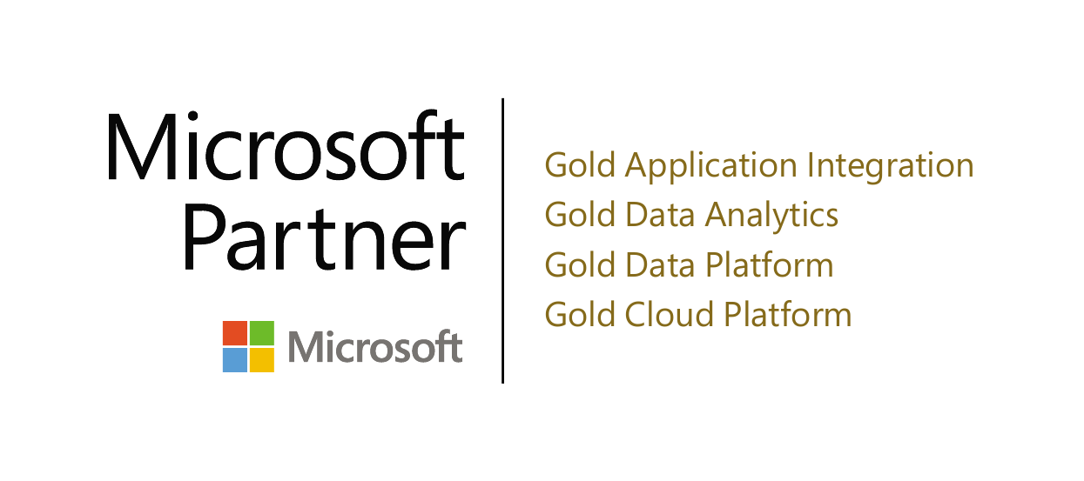
Thank you! (Time for questions)
Name: Eitan Blumin
Email: eitan@madeiradata.com
Blog: eitanblumin.com
Podcast: sqlserverradio.com | .co.il
Bluesky: eitanblumin.bsky.social
LinkedIn: linkedin.com/in/eitanblumin
GitHub: github.com/MadeiraData
madeiradata.com

