Slide 1

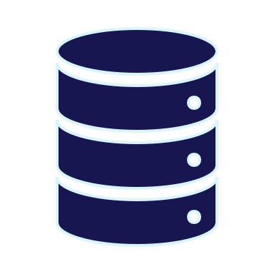

SSDT Methodologies
for SQL Server DevOps
By Eitan Blumin
Background by Dirk Wouters / Pixabay

Slide 2

Copyright © 2022 Madeira Ltd
All Rights Reserved
Full rights, including copyrights, belong exclusively to Madeira Ltd
No use of the materials, in any form, is allowed,
unless receiving a prior written permission from Madeira Ltd
Background by Dirk Wouters / Pixabay

Slide 3

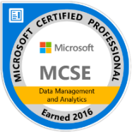



About Me…
Name: Eitan Blumin
Email: eitan@madeiradata.com
Blog: eitanblumin.com
Podcast: sqlserverradio.com | .co.il
Bluesky: eitanblumin.bsky.social
LinkedIn: linkedin.com/in/eitanblumin
MadeiraData.com
Notes:
Q: How to reach me?
Q: Where to find more resources? (blog)

Slide 4
SQL Server Data Tools (SSDT)
Methodologies for SQL Server DevOps
What is this about?
Who is it for?
Notes:
Refer to part 1: Development Lifecycle Basics for DBAs as prerequisite

Slide 5

Agenda
What? (is SSDT)
How? (Methodology)
  Wait, what? (Common issues)
Notes:
Q: What questions will we answer in this presentation?

Slide 6

What is SQL Server Data Tools?
Available for Free from Microsoft
Set of tools and project types for Microsoft Visual Studio, VS Code, and Azure Data Studio.
Combination of Extensions and Add-Ons
SQL Database Project
BI Project Types (SSRS, SSIS, SSAS)
Utilities:
  Schema and Data Compare
  Refactoring
  Unit Testing
https://docs.microsoft.com/sql/ssdt/
Notes:
Q: What is SSDT?
Q: How is SSDT used? (VS)
Q: What is contained within SSDT?

Slide 7
What is SQL Server Data Tools?
Build command:
  MSBuild.exe (for classic SSDT, Windows-only)
  dotnet build (for SDK-style SSDT, multi-platform)
Project artifact:
  .dacpac
Deployment command:
  SqlPackage.exe
  Powershell (DacServices / DbaTools)
Unit test project type:
  MSTest
Unit test execution:
  VSTest.Console.exe
https://docs.microsoft.com/sql/ssdt/
Notes:
Q: What is SSDT?
Q: How is SSDT used? (VS)
Q: What is contained within SSDT?

Slide 8
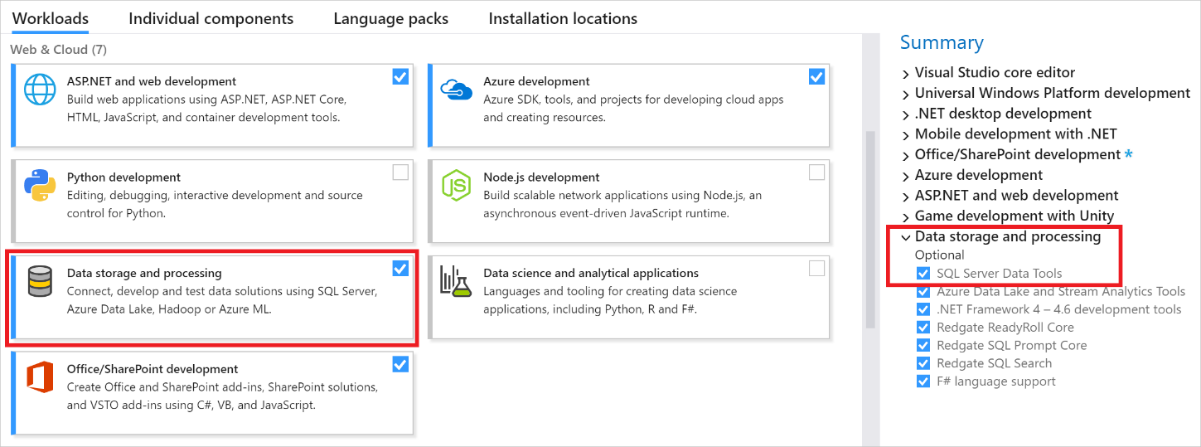
Installing SSDT (Tools and Features)
Tools > Get Tools and Features…
https://learn.microsoft.com/sql/ssdt/
Notes:
Q: How to install SSDT’s SQL Project? (Tools > Get Tools and Features…)
Q: What does the SSDT extension contain?

Slide 9
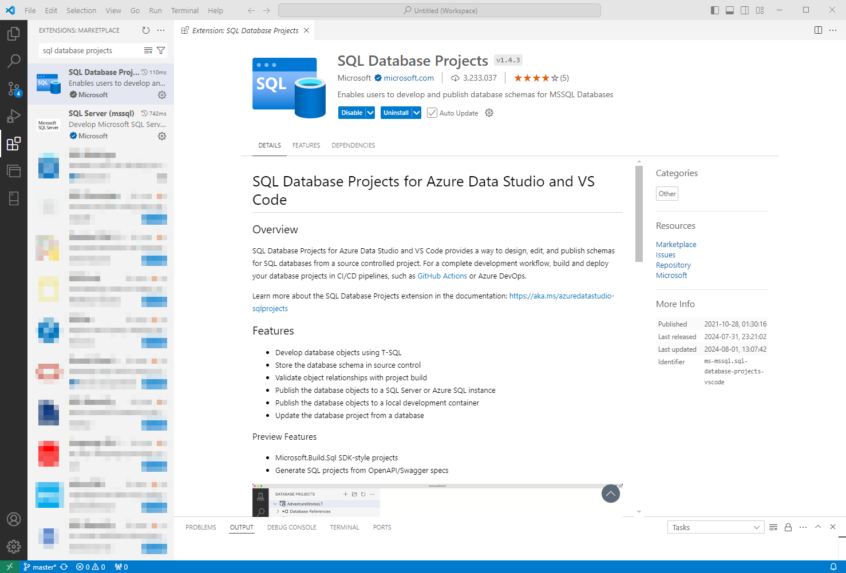
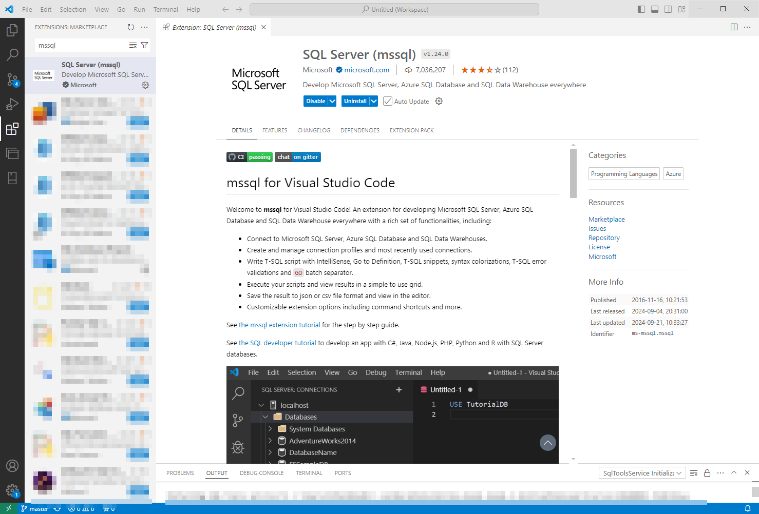
VS Code extensions
https://marketplace.visualstudio.com/items?itemName=ms-mssql.sql-database-projects-vscode

Slide 10
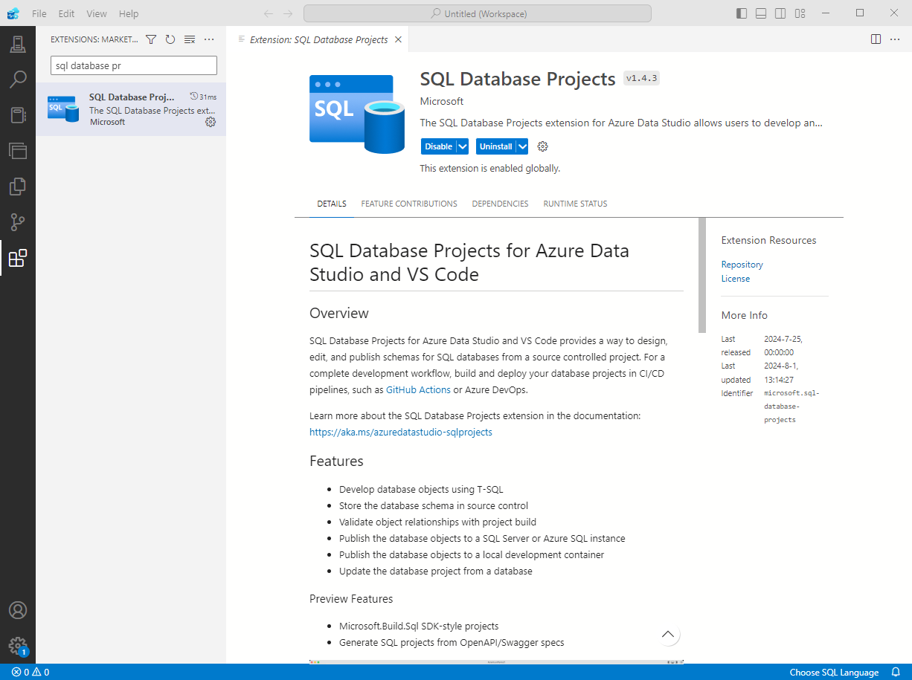
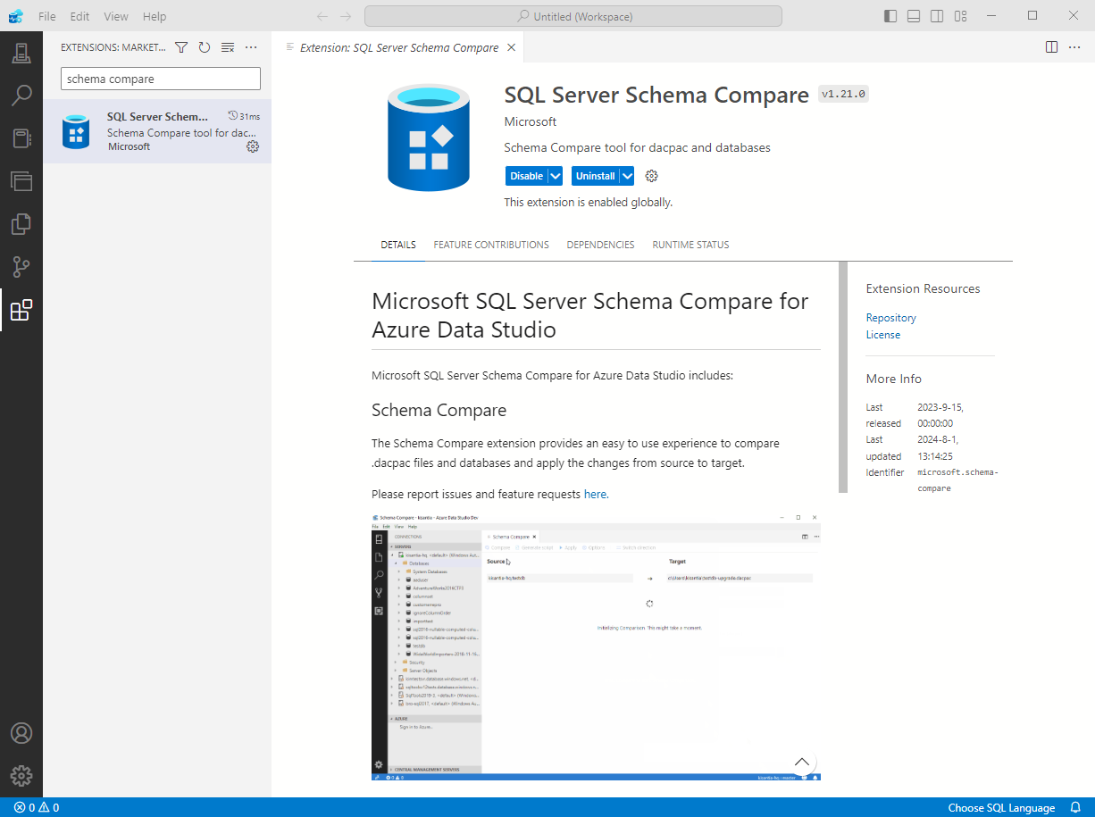
Azure Data Studio extensions
learn.microsoft.com/sql/azure-data-studio/extensions/sql-database-project-extension

Slide 11
How?
SSDT Methodology

Slide 12

How? SSDT Methodology
Deployment Artifact: DACPAC File
  Compressed, XML formatted
  Deployed using SQLPackage.exe / DacServices
  (most useful in automated CI/CD pipelines)
  Other forms of deployment are also available:
      Clean DB Creation script
      (drop + create from scratch)
      Manual deployment using Visual Studio
      Publish script generation for later use
      Schema Compare tool
Notes:
Q: What is the Build output of a SQL DB Project?
Q: What is a DACPAC file?
Q: How is it used?
Q: What other methods for deployment can we use in SSDT?

Slide 13

How? SqlPackage.exe
SqlPackage.exe /Action:Publish /SourceFile:”MyDB.dacpac” /Profile:”MyDB.publish.xml"
Compares dacpac to database
Generates a deploy (diff) script
Runs Pre-deployment script
Runs deploy script (generated in step 2)
Runs Post-deployment script
If not exists: CREATE DATABASE
MyDB_XX.publish.sql
Icons by Vectors Market / flaticon.com
https://docs.microsoft.com/sql/tools/sqlpackage
Notes:
Q: How is a DACPAC actually deployed?
Q: How to use SqlPackage.exe?
Q: What are the steps in DACPAC deployment?
Q: Why is this order of steps important, and how can we utilize it for our benefit?
Read more:
Using “pre-pre-deployment” scripts to run something before the compare phase: https://the.agilesql.club/2015/07/pre-compare-pre-deployment-scripts-to-ssdt/

Slide 14

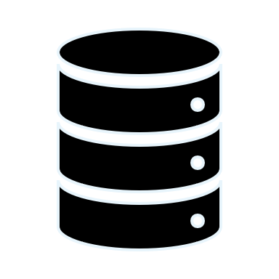




How? SSDT Methodology
State Based:
(SSDT, SqlPackage.exe)
State-Based Deployment
  Single Source of Truth
  (Desired End State)
  Pre/Post-Deployment scripts,
  and the Refactor tool can
  be used to simulate
  semi-Migration-Based
  methodology
Schema Compare
DACPAC /
DB Project
database
Execute
Migration based:
(NOT SSDT)
Diff / Publish
Script
.sql
Init
.sql
(v1)
Diff
.sql
(v2)
Diff
.sql
(v…)
Diff
.sql
(latest)
Notes:
Q: How is SSDT intended to be used?
Q: What is State-Based Methodology?
Q: What is Migration-Based Methodology? What are example tools that use it?
Q: What are the advantages of each methodology?
Q: How can we use SSDT to solve issues inherent in State-Based that are solved in Migration-Based?

Slide 15
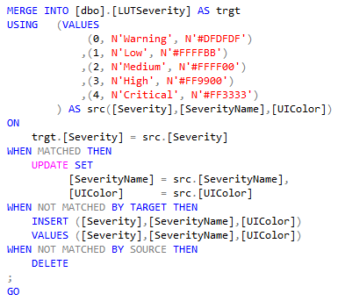

How? SSDT Methodology
Schema Only, No Data
  There are ways to
  circumvent that, though,
  using the Post-Deployment
  scripts
  sp_generate_merge:
  https://github.com/dnlnln/generate-sql-merge
Image by Rudy and Peter Skitterians / Pixabay
Notes:
Q: What is actually saved in a SQL DB Project?
Q: What if we want to have source control for data as well?

Slide 16
How? SSDT Methodology
Project = Database
  Some support for server-level
  objects also exists
  You can add “Database References”
  to your project for same-database,
  cross-database, or cross-server
  code dependencies
  Other server-level objects can be
  managed “manually” using
  Post-Deployment scripts
Notes:
Q: What does each project in SSDT represent?
Q: What if we want to have source control for server-level objects?
Q: What if your code uses other databases or linked servers or system objects?

Slide 17
How? SSDT Methodology
Each Object = Separate SQL Script File
  More accurately: Separate SQL batch per object
  Each object only has its CREATE script (desired end-state)
  This allows granular work and Version History
  in Source Control
Notes:
Q: How is Source Control actually implemented in SQL DB Project?
Q: How does it allow better collaborative work and auditing?

Slide 18
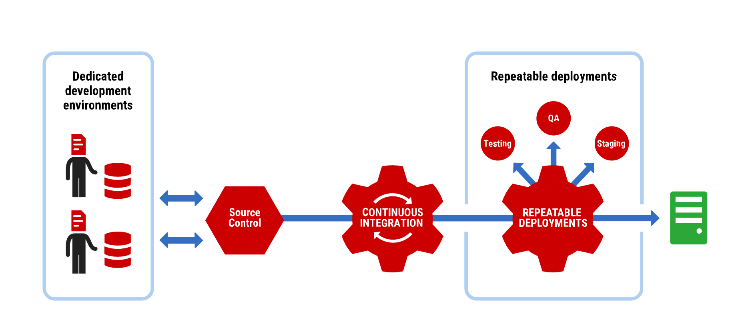

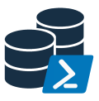


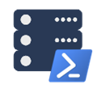


How? SSDT Methodology
Preferably Decoupled / Isolated Development
  DB development should mainly be done within Visual Studio / other IDE
  Each developer works against their own dedicated local database
      No “shared development” database server (it’s an anti-pattern)
      Never develop directly on a production server
  Integration / Build tests should be continuous
      Based on source-control commits
DbaClone
DbaTools
Notes:
Q: What is the ideal / preferable development methodology with SSDT?
Shared Development server anti-pattern:
https://www.red-gate.com/blog/architecting-database-dev-and-test-environments-best-practices-and-anti-patterns-for-sql-server
Example CloneDB technologies:
Red-Gate SQL Clone: https://www.red-gate.com/products/dba/sql-clone/
Red-Gate Data Masker: https://www.red-gate.com/products/dba/data-masker/
DbaClone (previously PSDatabaseClone) - Powershell module: https://github.com/sqlcollaborative/dbaclone/wiki
DbaTools (for Data Masking): https://github.com/sqlcollaborative/dbatools , https://docs.dbatools.io/#Invoke-DbaDbDataMasking

Slide 19
SSDT Methodology: Summary
Deployment Artifact: DACPAC File
State-Based Deployment
Schema Only, No Data
Project = Database
Each Object = Separate SQL Script File
Preferably Decoupled / Isolated
Development
Notes:
Recap

Slide 20

Solutions to Edge Cases
& Common Issues
Refactor Tool
Database References
Pre-Deployment Scripts & Post-Deployment Scripts
SQLCMD Variables
Publish Profiles
Notes:
Q: What are common problems encountered when first starting to use SSDT?
Q: How to solve them?

Slide 21





Abnormal Issues
Keep in mind:
Some abnormal deployment use cases may be easier to implement using traditional, manual migration scripts, rather than working around SSDT or CI/CD limitations.
SSDT would still be ideal for common daily development.
1
Manual Deployment
DBA
Production
2
Desired State
SSDT
Source Control
3
CI/CD (no effect)
Notes:
Q: What are common problems encountered when first starting to use SSDT?
Q: How to solve them?

Slide 22








CI/CD with SSDT - The Important Part
MSBuild.exe | dotnet build – Builds the project and generates DACPAC
SqlPackage.exe / Powershell – Deploys DACPAC to DB
MSTest.exe / VSTest.Console.exe – Execute Unit Tests
https://docs.microsoft.com/visualstudio/msbuild
https://docs.microsoft.com/sql/tools/sqlpackage
https://docs.dbatools.io/#Publish-DbaDacPackage
https://docs.microsoft.com/visualstudio/test/vstest-console-options
Everything else is a wrapper.
Speak with your DevOps team!
Sample Azure DevOps YML: SanderStad @ GitHub
Notes:
Q: This is what’s important for the DevOps team to know
Azure Pipeline example YML and Powershell scripts: https://github.com/sanderstad/SSDT-With-tSQLt-Template/tree/master/Build

Slide 23
Additional Resources
“The Azure DevOps duet” - Kevin Chant and Sander Stad
GitHub.com/SanderStad – Templates and starter scripts
“Zero Downtime Database Deployments” - Alex Yates
“Unit Testing with SSDT” - Andrey Zavadskiy
docs.microsoft.com/sql/ssdt/
docs.microsoft.com/sql/ssdt/project-oriented-offline-database-development
More resources are created every day!

Slide 24
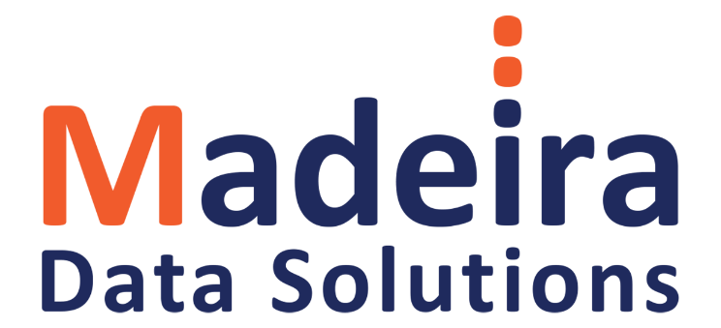
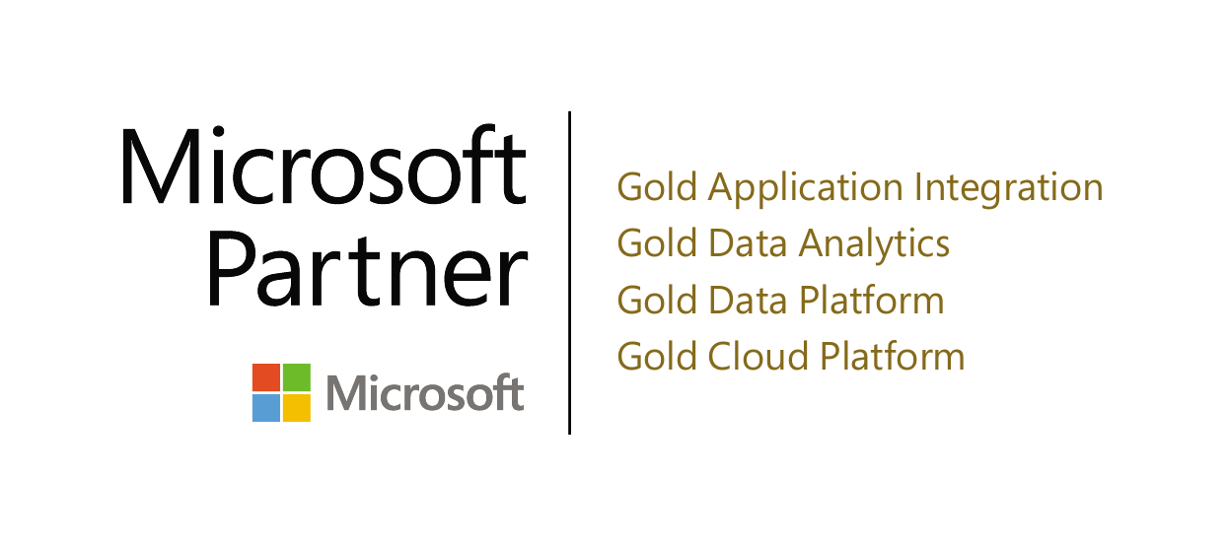
Thank you! (Time for questions)
Name: Eitan Blumin
Email: eitan@madeiradata.com
Blog: eitanblumin.com
Podcast: sqlserverradio.com | .co.il
Bluesky: eitanblumin.bsky.social
LinkedIn: linkedin.com/in/eitanblumin
GitHub: github.com/MadeiraData
madeiradata.com

