Slide 1
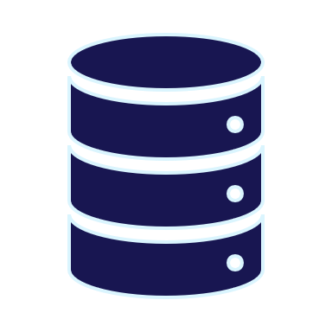
Development Lifecycle Basics for DBAs
By Eitan Blumin
Image by Dirk Wouters / Pixabay

Slide 2
Copyright © 2023 Madeira Ltd
All Rights Reserved
Full rights, including copyrights, belong exclusively to Madeira Ltd
No use of the materials, in any form, is allowed,
unless receiving a prior written permission from Madeira Ltd
Image by Dirk Wouters / Pixabay

Slide 3
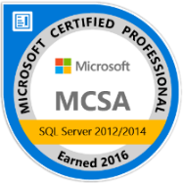
About Me…
Name: Eitan Blumin
Email: eitan@madeiradata.com
Blog: eitanblumin.com
Podcast: sqlserverradio.com \ .co.il
Bluesky: eitanblumin.bsky.social
LinkedIn: linkedin.com/in/eitanblumin
MadeiraData.com
Notes:
Q: How to reach me?
Q: Where to find more resources? (blog)

Slide 4
Development Lifecycle Basics for DBAs
What is this about?
Who is it for?

Slide 5
Part 1 - Agenda
Why? (Database DevOps)
What…
… is Source Control?
… are Unit Tests?
… are CI / CD Pipelines?
… is SSDT?
Notes:
Q: What questions will we answer in this presentation?

Slide 6
Database DevOps – Why?
Once upon a time… The classic DBA’s tool set:
Custom-built.
Gets you from A to B.
Closely familiar with deepest inner workings.
Old and outdated.
Takes too much time to use and maintain.
Heavily prone to user error.
Photo by Joshua Willson
Notes:
Q: What was the classic DBA’s tool set until a few years ago?
Q: Why is it good?
Q: Why is it bad?
Q: Is this problem still relevant today?

Slide 7
Database DevOps – Why?
Once upon a time… The classic DBA’s tool set:
Main development tool:
SSMS
Source Control:
DBA’s workstation / File server / Live
Version History:
Dropbox/Onedrive/etc. (if at all)
Unit Testing:
Huh?
CI / CD:
LOL
Photo by Joshua Willson
Notes:
Q: What was the classic DBA’s tool set until a few years ago?
Q: Why is it good?
Q: Why is it bad?
Q: Is this problem still relevant today?

Slide 8
Meanwhile, in the room next door…
The Software Developer’s
tool set:
Early error detection.
Automated testing.
Automated integration.
Automated deployment.
Collaborative development.
Cool “toys” (extensions, plugins, templates, etc.)
Image by Ubisoft’s Star Trek: Bridge Crew, VentureBeat
Notes:
Q: What kind of tool set do software developers use?

Slide 9
Meanwhile, in the room next door…
The Software Developer’s
tool set:
Main development tool:
Visual Studio / VS Code
Other IDEs
Source Control
Version History
Unit Testing
CI / CD
Image by Ubisoft’s Star Trek: Bridge Crew, VentureBeat
Notes:
Q: What kind of tool set do software developers use?

Slide 10
Database DevOps – What for?
Individual
Big & Infrequent Deployments
Team
Small & Frequent Deployments
But…. Database DevOps is HARD!
Notes:
Q: What are the actual differences in the tool sets used by software devs and DBAs?
Focus on: Team=Good vs Individual=Bad
Q: Do we really need to invest in better tool sets for the database?
Q: Why is it important?
Q: Why don’t more people use better tool sets for database development?
Q: What makes DB DevOps so much harder than Software DevOps?

Slide 11
CI/CD: Our End Goal
Developer
Source Control
Automated Deployment
Automated Tests

Slide 12
CI/CD: Benefits
Developer
Source Control
Automated Deployment
Automated Tests
Earlier error detection
Less errors in production
Faster deployments
Consistent & reliable deployments
Less prone to human-error
Faster Time to Market
Less production failures
Better availability
Less TIME wasted
More MONEY earned
Learn more in Part 0: Database DevOps for Leaders
Notes:
https://eitanblumin.com/portfolio/ci-and-cd-with-ssdt-part-0-database-devops-for-leaders/

Slide 13
Git Source Control
Basic Terms & Methodologies
Notes:
Before diving into SSDT, we must familiarize ourselves with DevOps terminology and development lifecycle basics

Slide 14
Git Basics
commit
/ pull / undo
IDE
Image by 4tecture
Notes:
Q: What is a local repository and a shared repository? What is a “clone”?
Q: What is a “commit”? What is an “undo”?
Q: What is a “push”?
Q: What is a “pull”? What is a “fetch”?
Read more: https://www.4tecture.ch/blog/2013/11/08/tfs-2013-tfvc-vs-git/

Slide 15
Git Basics
❌
✔
Split
Merge
Pull Request
Notes:
Q: What are “branches”?
Q: What is a “split”?
Q: What are “pull request” and “merge”?

Slide 16
Git Flow Basics
main
push / pull
Local Repository
commit
/ pull / undo
IDE
Image by NuRelm
Notes:
Q: What is the meaning and usage of the standard GitFlow branches? (master, develop, release, hotfix, feature)
Q: What other branching policies are out there? (GitHub, Trunk, …)

Slide 17
Git Flow Basics
main must always reflect what is on the production server.
develop reflects current development in progress at the team / organization level.
feature reflects current development at the individual developer / feature level.
release reflects a pending release with (possibly) last-minute changes.
hotfix reflects “emergency” fixes that must be pushed to production ASAP.
main
Image by NuRelm
Notes:
master: also track the server’s database.
develop: test the recently added features.
release-*: use for final changes to ensure stability prior to release.
hotfix-*: used for bugfixes or other “emergency” development work.
feature-*: used for new features or refactoring related development work.

Slide 18
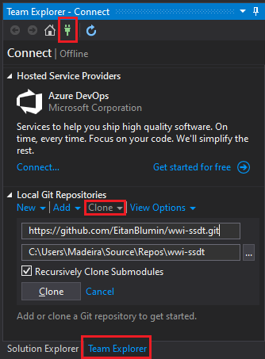
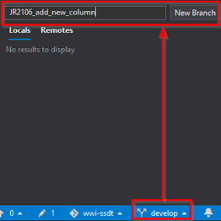
Development Lifecycle Basics
clone repository
split branch
Notes:
Q: What does a standard GitFlow process look like?

Slide 19
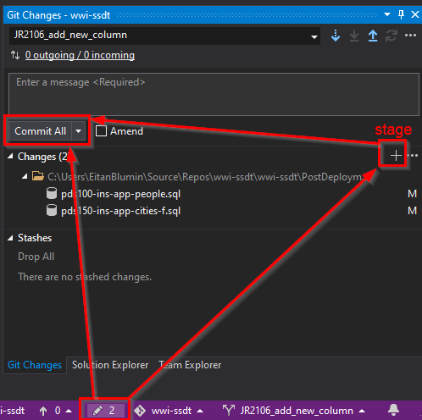
Development Lifecycle Basics
clone repository
split branch
commit changes
Notes:
Q: What does a standard GitFlow process look like?

Slide 20
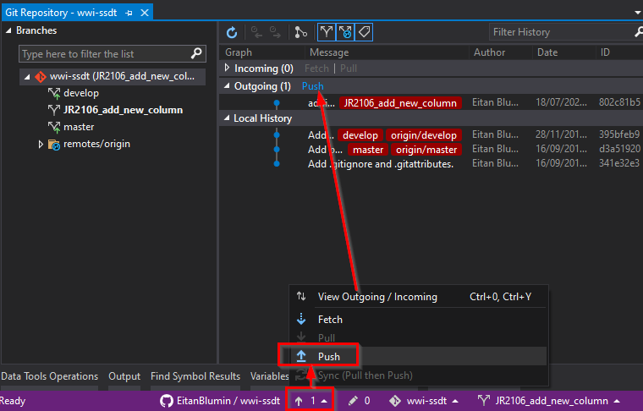
Development Lifecycle Basics
clone repository
split branch
commit changes
push
Notes:
Q: What does a standard GitFlow process look like?

Slide 21
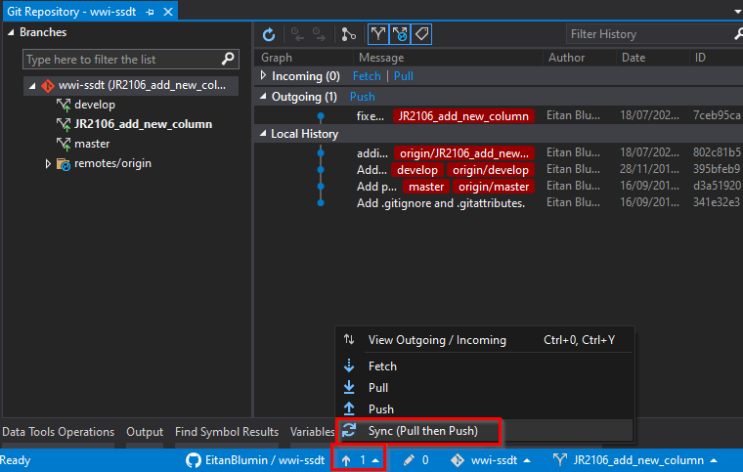
Development Lifecycle Basics
clone repository
split branch
work cycle
pull
push
commit changes
“sync”
Notes:
Q: What does a standard GitFlow process look like?

Slide 22
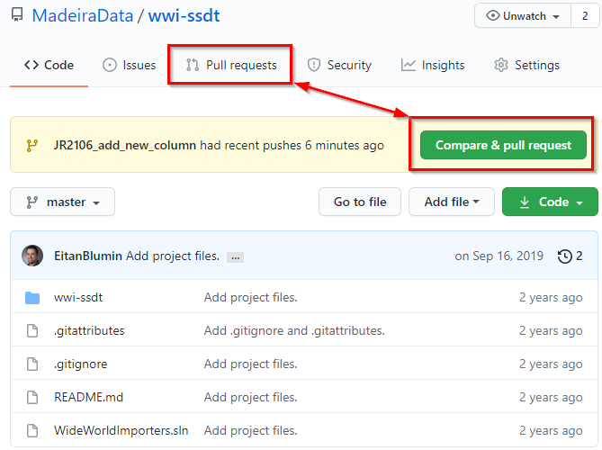
Development Lifecycle Basics
clone repository
split branch
work cycle
create pull request
Notes:
Q: What does a standard GitFlow process look like?

Slide 23
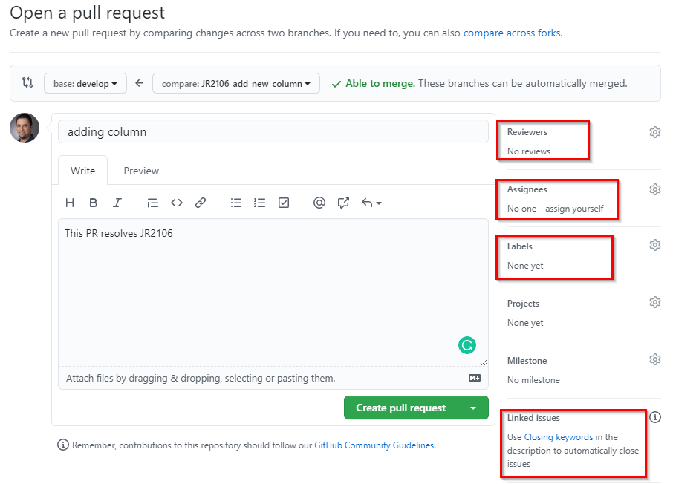
Development Lifecycle Basics
clone repository
split branch
work cycle
create pull request
Notes:
Q: What does a standard GitFlow process look like?

Slide 24
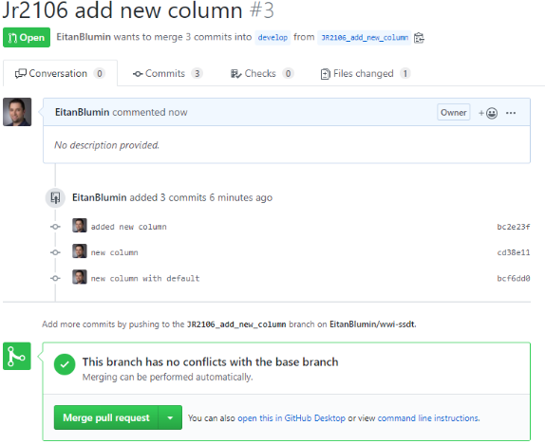
Development Lifecycle Basics
clone repository
split branch
merge branch
work cycle
review & approval
create pull request
Notes:
Q: What does a standard GitFlow process look like?

Slide 25
Popular Git Source Control Tools
GitHub
GitLab
BitBucket (Atlassian)
Azure Repos (Azure DevOps)
Also non-Git source control tools (TFS, SVN, etc.)
Ask the software developers or PM in your organization
(Visual Studio integrates with all of them via Extensions)

Slide 26
CI/CD & DevOps
Basic Terms:
- Unit Tests
- Artifacts
Notes:
Hopefully your organization already has DevOps methodologies implemented somewhere

Slide 27
What are Unit Tests?
Most granular and basic level of tests
Defined per single function/method
“State-machine” type tests
Input->expected output
Integral part of the CI/CD pipeline
Automated
Meant to immediately detect breaking changes
Difficult and time-consuming to design and implement
Visual Studio project type: MSTest

Slide 28
What is an Artifact?
Build
Deploy
Production
Project
Artifact
Target
more stuff happen here

Slide 29
What is an Artifact?
Build
Deploy
Production
Project
Artifact
Target
.dll , .exe , .msi , .ispac , .dacpac , ...

Slide 30
CI/CD Pipelines
Common Methodologies

Slide 31
Example CI/CD Pipeline
build
log
trigger
deploy
tests
log
approval
copy
Test / QA Server
Staging Server
Production Server
Notes:
Q: What other kinds of development lifecycles are there?
Q: Which servers can be the targets of CI/CD? When? Why?

Slide 32
Example CI/CD Pipeline
build
log
trigger
Build Pipeline
deploy
tests
log
approval
copy
CI (Build / Integration)
CD (Delivery)
Release
Pipeline(s)
CD (Deployment)
Notes:
Q: What other kinds of development lifecycles are there?
Q: Which servers can be the targets of CI/CD? When? Why?

Slide 33
Triggering CI/CD via Source Control
main
Pull Request -> Build, CI Pipeline
Develop branch -> Test / QA Server, CD Pipeline
Release and Hotfix branches -> Staging Server, CD Pipeline
Main branch -> Production Server, CD Pipeline
Image by NuRelm
Notes:
Q: What kind of Git operations may trigger a CI/CD pipeline?
Q: What kind of target server would be designated for which Git branch?

Slide 34
Popular CI/CD Pipeline Tools
Azure Pipelines (VSTS Pipelines)
GitHub Actions
Bamboo (Atlassian)
GitLab
AWS CodePipelines / CodeDeploy
Jenkins
Travis CI
TeamCity
Octopus Deploy
And many many many more
Image by Gerd Altmann / Pixabay
Notes:
Q: What different CI/CD providers are there?
(left to right, top to bottom)

Slide 35
… and many more
Ask the DevOps guy / team in your organization

Slide 36
What is SQL Server Data Tools?
Available for Free from Microsoft
Set of tools and project types for Microsoft Visual Studio, VS Code, and Azure Data Studio.
Combination of Extensions and Add-Ons
SQL Database Project
BI Project Types (SSRS, SSIS, SSAS)
Utilities:
Schema and Data Compare
Refactoring
Unit Testing
https://docs.microsoft.com/sql/ssdt/
Notes:
Q: What is SSDT?
Q: How is SSDT used? (VS)
Q: What is contained within SSDT?

Slide 37
What is SQL Server Data Tools?
Build command:
MSBuild.exe (for classic SSDT, Windows-only)
dotnet build (for SDK-style SSDT, multi-platform)
Project artifact:
.dacpac
Deployment command:
SqlPackage.exe
Powershell (DacServices / DbaTools)
Unit test project type:
MSTest
Unit test execution:
VSTest.Console.exe
https://docs.microsoft.com/sql/ssdt/
Notes:
Q: What is SSDT?
Q: How is SSDT used? (VS)
Q: What is contained within SSDT?

Slide 38
Check out “Part 2”
SSDT Methodologies for DB DevOps By Eitan Blumin https://eitanblumin.com/portfolio/ci-cd-ssdt-methodologies-for-db-devops/
Series index page:
https://eitanblumin.com/project-type/ci-and-cd-with-ssdt/
Or https://eitanblumin.com/cicd

Slide 39
Additional Resources
“Introduction to GitHub for DBAs” – Brent Ozar
“The Azure DevOps duet” - Kevin Chant and Sander Stad
GitHub.com/SanderStad – Templates and starter scripts
“Zero Downtime Database Deployments” - Alex Yates
“Unit Testing with SSDT” - Andrey Zavadskiy
docs.microsoft.com/sql/ssdt/project-oriented-offline-database-development
More resources are created every day!

Slide 40
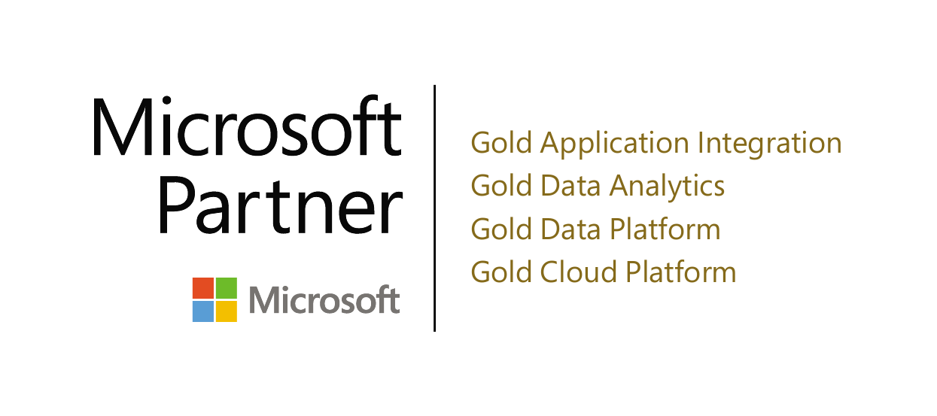
Thank you! (Time for questions)
Name: Eitan Blumin
Email: eitan@madeiradata.com
Blog: eitanblumin.com
Podcast: sqlserverradio.com \ .co.il
Bluesky: eitanblumin.bsky.social
LinkedIn: linkedin.com/in/eitanblumin
GitHub: github.com/MadeiraData
https://eitanblumin.com/cicd
www.madeiradata.com

