Slide 1
The DBA’s Essential Toolkit
free

Slide 2
Copyright © 2025 Madeira Ltd
All Rights Reserved
Full rights, including copyrights, belong exclusively to Madeira Ltd
No use of the materials, in any form, is allowed,
unless receiving a prior written permission from Madeira Ltd

Slide 3
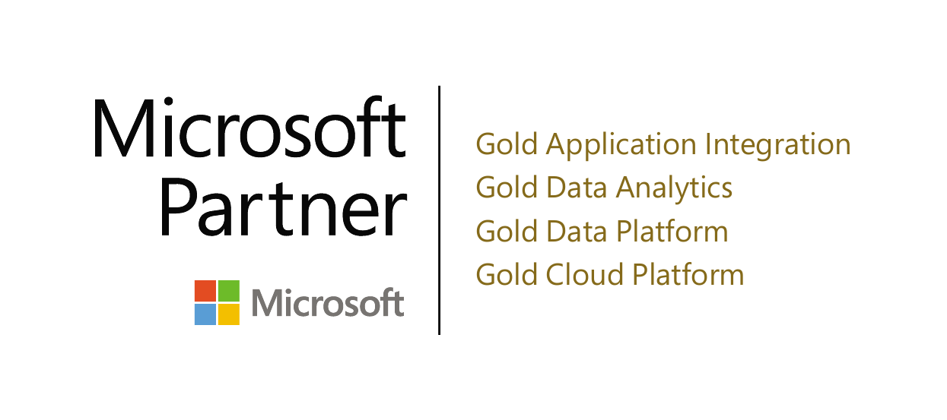
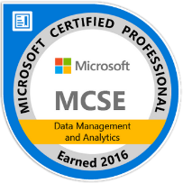
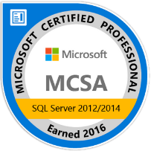
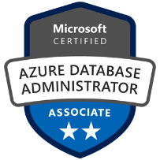
Eitan Blumin
Expert SQL Server Consultant
CTO
Solutions Architect
Email: eitan@madeiradata.com
Twitter: @EitanBlumin
LinkedIn: linkedin.com/in/eitanblumin
Blog: EitanBlumin.com
Podcast: SqlServerRadio.co.il
SqlServerRadio.com
MadeiraData.com

Slide 4
Why is this important?
1989 - SQL Server 1.0
2001 – SQLServerCentral
2006 – MSSQL Tips
2008 – GitHub
2008 – Stack Overflow
2011 – DBA’s Stack Exchange
2018 – Microsoft $ GitHub

Slide 5
The Importance of Community
Free
New viewpoints
Breadth of (unattainable) experience
Cure Dunning Kruger effect
Work hours
Fun and wholesome

Slide 6
Agenda
💽 Free SQL Server Offerings
🔨 Free & Open-Source Tools
🤝 Communities and Forums
🎓 Educational Resources
👍 Honorable Mentions

Slide 7
Free SQL Server Offerings
VM / On-Prem
SQL Server Developer Edition
SQL Server Express Edition
Cloud
Azure SQL free Database offer
Amazon RDS free offer
Notes:
https://www.microsoft.com/en-us/sql-server/sql-server-downloads
https://techcommunity.microsoft.com/blog/azuresqlblog/introducing-the-enhanced-azure-sql-database-free-offer-now-generally-available/4372418
https://aws.amazon.com/free/database/

Slide 8
Free & Open-Source Tools
Official Microsoft Tools:
SQL Server Management Studio (SSMS)
Azure Data Studio [deprecated]
VS Code
Visual Studio Community Edition
SQL Server Data Tools (SSDT)
Notes:
https://learn.microsoft.com/en-us/ssms/download-sql-server-management-studio-ssms
https://azure.microsoft.com/en-us/products/data-studio
https://code.visualstudio.com/download
https://visualstudio.microsoft.com/vs/community/
https://learn.microsoft.com/en-us/sql/ssdt/download-sql-server-data-tools-ssdt

Slide 9
Free & Open-Source Tools
Essential Tools:
Sp_WhoIsActive
Glenn Berry’s SQL Server Diagnostic Queries
CISL (Columnstore Indexes Script Library)
Notes:
https://github.com/amachanic/sp_whoisactive/releases
https://glennsqlperformance.com/resources/
https://github.com/NikoNeugebauer/CISL

Slide 10
Free & Open-Source Tools
SqlCollaborative Powershell Modules:
DbaTools
DbaChecks
DbaClone
DbOps (DbUp)
DbaSecurityScan
DbaDISA (STIG Automation)
github.com/dataplat
Notes:
https://dbatools.io/
https://github.com/dataplat
https://dbup.github.io/

Slide 11
Free & Open-Source Tools
Maintenance Solutions:
Ola Hallengren’s Maintenance Solution:
DatabaseBackup
DatabaseIntegrityCheck
IndexOptimize
Tiger Toolbox Maintenance Solution:
AdaptiveIndexDefrag
AdaptiveCycleErrorLog
CheckIntegrity
AzureSQLMaintenance (index / stat)
Notes:
https://ola.hallengren.com/
https://github.com/microsoft/tigertoolbox/tree/master/MaintenanceSolution
https://github.com/yochananrachamim/AzureSQL/blob/master/AzureSQLMaintenance.txt

Slide 12
Free & Open-Source Tools
Madeira’s Maintenance Solutions:
Maintenance.CleanupHistory
Maintenance.CleanupMSDB
Maintenance.IncrementalIntegrityCheck
Maintenance.RecycleLogFiles
Maintenance.UpdateStatistics
Test-DbaBackup.ps1
SQLVersionUpdates
Various Ola Hallengren adaptations
And more
Notes:
https://github.com/MadeiraData/microsoft-dbas-club/tree/master/Maintenance

Slide 13
Free & Open-Source Tools
Madeira’s Open-Source Solutions:
DatabaseFileSizeMaintenance
MSSQL-Jobs-HADR
SqlServerReview
AutoRestoreTest
DynamicFilters
Powershell Remote Execution
ClrHttpRequest
SqlClrJsonParser
SQL-CLR-ICS
FileOperationsCLR
And more
Notes:
https://github.com/orgs/MadeiraData/repositories

Slide 14
Free & Open-Source Tools
Open-Source Toolkits:
First Responder’s Kit (Brent Ozar’s sp_Blitz)
Microsoft DBA’s Club (Madeira’s Toolbox)
Microsoft’s Tiger Toolbox
Azure-SQL-Tips
SQLUndercover Toolbox
David Schanzer’s DBA Toolbox
Erik Darling’s DBA Procedures
And more
Notes:
https://www.brentozar.com/first-aid/
https://github.com/MadeiraData/microsoft-dbas-club
http://aka.ms/tigertoolbox
https://github.com/microsoft/azure-sql-tips
https://github.com/SQLUndercover/UndercoverToolbox
https://github.com/DavidSchanzer/Sql-Server-DBA-Toolbox
https://erikdarling.com

Slide 15
Communities and Forums
Microsoft’s Tech Community Hub
Microsoft Q&A – SQL Server
Microsoft DBA’s Club (WhatsApp group)
r/SQLServer
DBA Stack Exchange
SQL Server on Stack Overflow
Notes:
https://techcommunity.microsoft.com/category/sql-server/discussions/sql_server
https://learn.microsoft.com/en-us/answers/tags/191/sql-server
https://www.madeiradata.com/microsoftdbasclub
https://www.reddit.com/r/SQLServer/
https://dba.stackexchange.com/
https://stackoverflow.com/questions/tagged/sql-server

Slide 16
Communities and Forums
Online Meetups:
Microsoft DBA’s Club
Data Platforms GlobalHebrew
SQLFriday.net
Cloud Data Driven
DBA Fundamentals Group
GroupBy.org
And more
Notes:
https://www.meetup.com/microsoft-dbas-club
https://www.meetup.com/data-platforms-globalhebrew
https://www.meetup.com/sql-Friday
https://www.meetup.com/cloud-data-driven
https://www.meetup.com/dba-fundamentals-group
http://groupby.org/
https://www.meetup.com/pro/azuredatatechgroups/

Slide 17
Educational Resources
Online Magazine / Collaborative Blogs:
SQLServerCentral.com
Stairway series
QotD
MSSQLTips.com
Red-Gate Simple-Talk
SQLPerformance.com
Podcasts:
SQLServerRadio.com
SQLServerRadio.co.il
SQL Data Partners Podcast
And more
Notes:
https://sqlservercentral.com/
https://mssqltips.com/
https://www.red-gate.com/simple-talk/
https://sqlperformance.com/
https://sqlserverradio.com/
https://sqlserverradio.co.il/
https://www.youtube.com/c/sqldatapartners
https://learnsql.com/blog/sql-podcasts-to-listen/

Slide 18
Educational Resources
Microsoft Tech Community Blogs:
SQL Server Blog
SQL Server Support Blog
Azure Database Support Blog
Azure SQL Blog
Madeira Blogs:
Madeira Data Solutions Blog
Eitan Blumin’s Blog
Other Blogs:
Brent Ozar’s Blog (and YouTube channel)
Curated SQL
T-SQL Tuesday
Notes:
https://techcommunity.microsoft.com/category/sql-server/blog/sqlserver
https://techcommunity.microsoft.com/category/sql-server/blog/sqlserversupport
https://techcommunity.microsoft.com/category/azuredatabases/blog/azuredbsupport
https://techcommunity.microsoft.com/category/azuredatabases/blog/azuresqlblog
https://www.madeiradata.com/blog
https://www.eitanblumin.com/
https://www.brentozar.com/blog/
https://curatedsql.com/
https://tsqltuesday.com/

Slide 19
Honorable Mentions
Microsoft SQL Server Trace Flags
Microsoft SQL Server Versions List (unofficial)
Updates and Version History for SQL Server (official)
Sp_Generate_Merge
ColumnScore.com
SQLCallStackResolver
aka.ms/SQLShortcuts
SQLServerFast.com
Notes:
https://github.com/ktaranov/sqlserver-kit/blob/master/SQL Server Trace Flag.md
https://sqlserverbuilds.blogspot.com/
https://github.com/MicrosoftDocs/SupportArticles-docs/blob/main/support/sql/releases/download-and-install-latest-updates.md
https://github.com/dnlnln/generate-sql-merge
https://columnscore.com/
https://github.com/microsoft/SQLCallStackResolver
https://aka.ms/SQLShortcuts
https://sqlserverfast.com/

Slide 20
Questions?
Anything to add?
i made this

