Slide 1

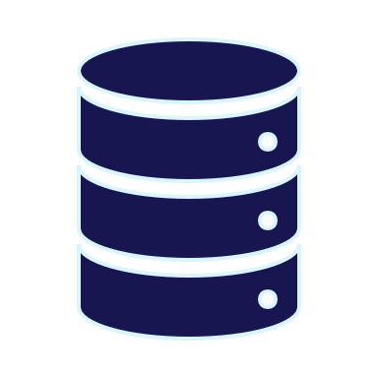

Database DevOps for Leaders
By Eitan Blumin
Image by Dirk Wouters / Pixabay

Slide 2


Copyright © 2024 Madeira Ltd
All Rights Reserved
Full rights, including copyrights, belong exclusively to Madeira Ltd
No use of the materials, in any form, is allowed,
unless receiving a prior written permission from Madeira Ltd
Image by Dirk Wouters / Pixabay

Slide 3


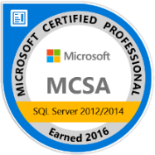


About Me…
Name: Eitan Blumin
Email: eitan@madeiradata.com
Blog: eitanblumin.com
Podcast: sqlserverradio.com | .co.il
Twitter: @EitanBlumin
LinkedIn: linkedin.com/in/eitanblumin
MadeiraData.com
Notes:
Q: How to reach me?
Q: Where to find more resources? (blog)

Slide 4
Database DevOps for Leaders
What is this about?
Who is it for?
Notes:
This session is about DevOps in general, and Database DevOps specifically.
What it is, what it’s for, its challenges and advantages, its ROI, and management-level best practices.
The target audience is anyone at C-level positions. Such as CEOs, CTOs, CIOs, and Team Leaders.

Slide 5

Agenda
The purpose of DevOps
What is DevOps
Why Database DevOps
Challenges of Database DevOps
Database DevOps ROI
Implementation of DB DevOps
Notes:
Q: What questions will we answer in this presentation?

Slide 6







The purpose of DevOps
Big & Infrequent
Deployments
Individual
Faster Time to Market
Team
Small & Frequent
Deployments
Fewer Production Errors

Slide 7
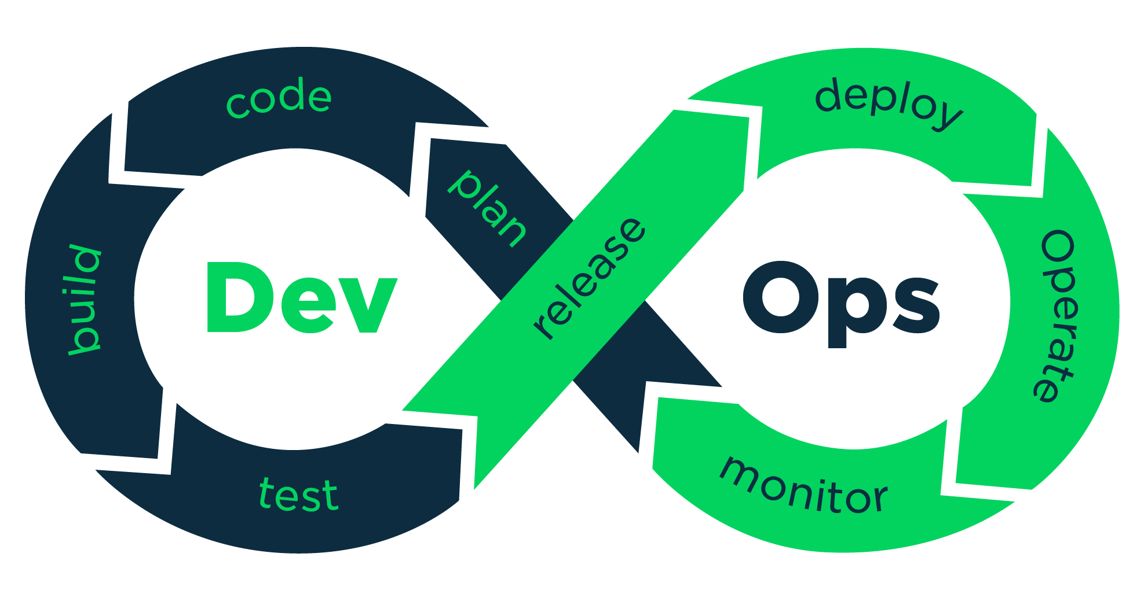
What is DevOps
This Photo by Unknown Author is licensed under CC BY-SA
Notes:
Automation and collaboration are key

Slide 8











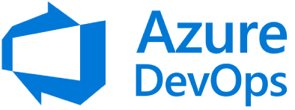










What is DevOps
Deployment
(automated)
Task Management
(work items)
QA Testing
(manual + automated)
Collaboration
(cross-disciplinary)
Source Control
+ Version History
This Photo by Unknown Author is licensed under CC BY-SA
Notes:
The nature of a source control system adds the following functionality:
Auditing of the changes made and the source of the change
The ability to undo, or rollback, changes to a database without requiring a restore
A known state for comparison between environments and tracking changes over time
An additional backup of the code that defines the database
The isolation of different development processes from each other

Slide 9




Our End Goal
Developer
Source Control
Automated Deployment
Automated Tests

Slide 10

Why (Database) DevOps
Developer
Source Control
Automated Deployment
Automated Tests
Earlier error detection
Less errors in production
Faster deployments
Consistent & reliable deployments
Less prone to human-error
Faster Time to Market
Less production failures
Better availability
Less TIME wasted
More MONEY earned

Slide 11
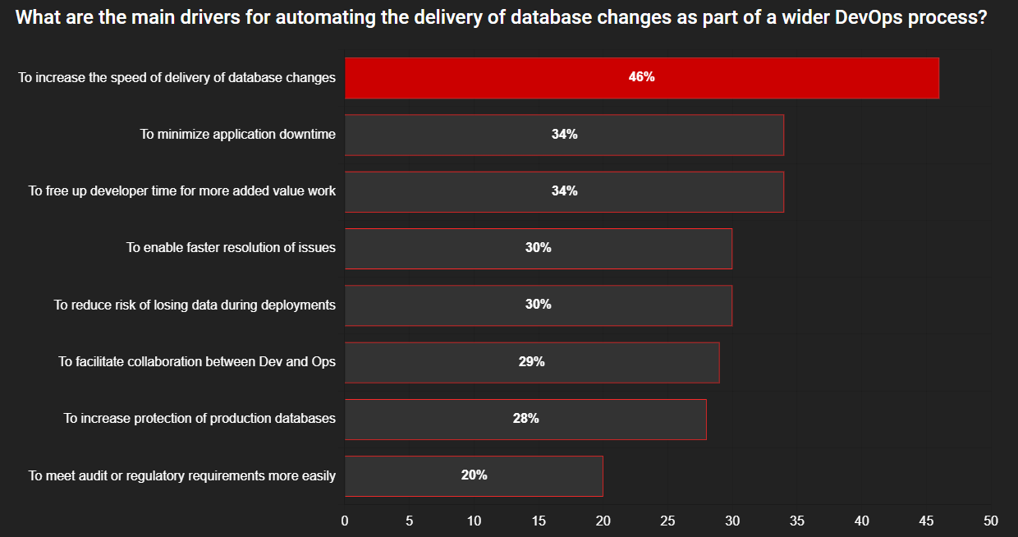
Time to Market is King
Source: The State of the Database Landscape 2024, Red-Gate
Notes:
Main driver: Time To Market
The top seven benefits of DevOps, according to those who are involved in, or are introducing DevOps, are:
The faster speed and lower cost of a release
Improved operational support and faster fixes
Faster time to market
Higher quality products
A lower volume of defects
Improved frequency of new releases and features
Good processes across IT and teams, including automation

Slide 12
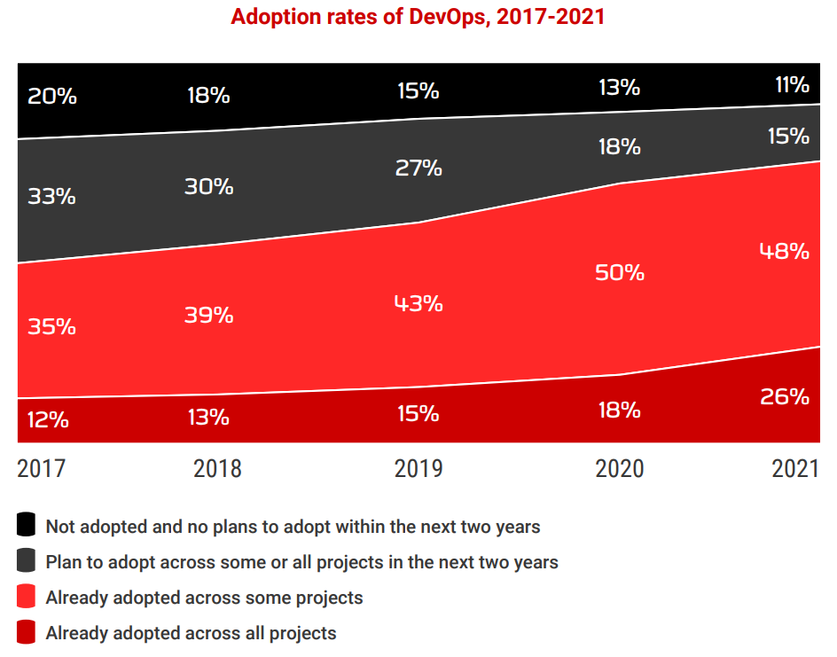
The Race is Already On
In 2017, 47% of respondents adopted Database DevOps fully or partially
In 2021, 74% of respondents adopted Database DevOps fully or partially
Adoption rates only continue rising
Source: The State of Database DevOps 2021, Red-Gate

Slide 13
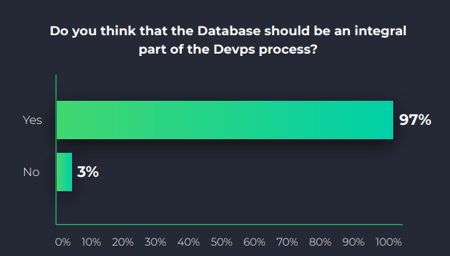
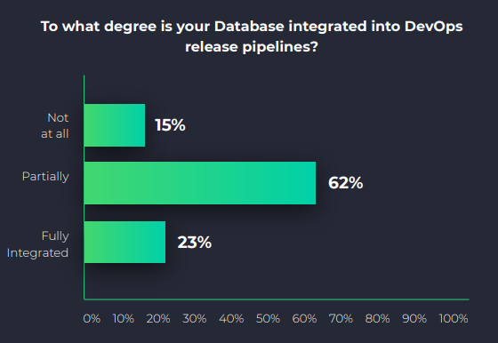
The Race is Already On
Nearly everyone (97%) agrees: the database should be an integral part of DevOps pipelines
Despite the universal desire to do so, only 23% of respondents have fully integrated the database into the DevOps pipelines to date.
62% for partial
integration is still a
high percentage
85% full or partial
integration is a
rather crazy number
Source: 2021 Database DevOps Survey, DBmaestro

Slide 14
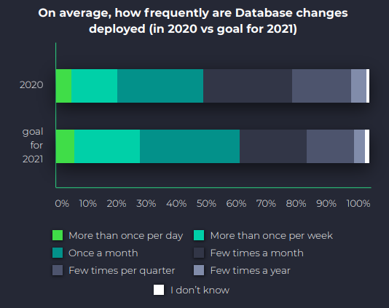
The Race is Already On
No matter how fast they go, everybody is trying to run faster. Across teams, accelerating release cycles is the top goal.
The speed of releases has accelerated:
  Only 5% of respondents releasing only a few times a year
  Nearly half (44%) are releasing between once a quarter and once a month.
  42% are releasing even faster - between once a month and a few times per week.
  Less than 5% of respondents were able to achieve the frequency of several times per day.
Source: 2021 Database DevOps Survey, DBmaestro
Notes:
No matter how fast they go, everybody is trying to run faster. Across teams, accelerating release cycles is the top goal.
The speed of releases has accelerated
Only 5% of respondents releasing only a few times a year
Nearly half (44%) are releasing between once a quarter and once a month.
42% are releasing even faster - between once a month and a few times per week.
Less than 5% of respondents were able to achieve the frequency of several times per day.
No matter how much we accelerate, most organizations want to accelerate further to deliver more capacity, faster, better, and at higher frequency than they do currently. DevOps culture has been highly focused on code and infrastructure layers to date—setting aside a critical component—the database. The database in a lot of organizations remains to be the last DevOps frontier that has tremendous potential to further accelerate the delivery process.

Slide 15
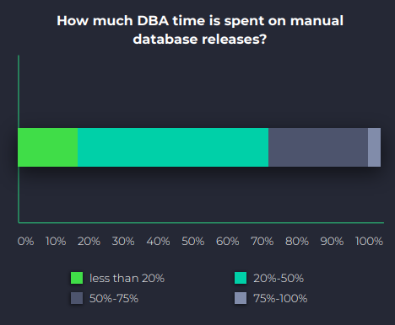
DBAs Hard at Work
DBAs still spend most of their time servicing manual database changes:
  Nearly half of DBAs spend up to 50% of their working hours on manual database releases.
  35% spend upwards of 75% of their working hours on manual database releases.
  3% of DBAs spend 100% of their working hours manning manual database release processes.
Source: 2021 Database DevOps Survey, DBmaestro
Notes:
One in three industry professionals (34%) replied that over half of DBA time is spent on managing manual database releases, with over 3% spending 100% of their day on manual release tasks.
These high rates could be an indication of a widespread “ineffective” implementation of DB DevOps.
But it could also mean much “leaner” definition of a DBAs responsibility.

Slide 16
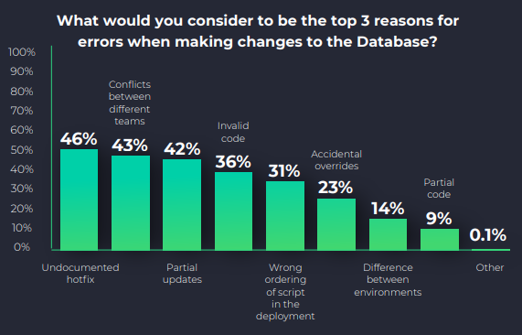
DB DevOps Still Not Properly Implemented
Source: 2021 Database DevOps Survey, DBmaestro
Notes:
Different teams disagree on the top reason for errors when making changes to the databases.
While developers want to make changes fast, the DBAs strive to preserve stability. Nobody is wrong, but the discrepancy between the incentives creates a conflict of interests and inevitably leads to a reduction in quality owing to less testing, more release issues, and lack of collaboration between the teams.
The application deployment process has a built-in safety mechanism based on source control for the binaries. For them, there is no way to copy binaries into the production (or previous environments) from other sources (e.g., a local developer PC)
With the database, however, there are people who have permissions to log in and perform changes directly in the database even in the production environment, and there is no notification or safety net mechanism to handle such changes.

Slide 17



Database DevOps ROI
Notes:
Calculating ROI of implementing Database DevOps is not easy, but it’s possible.
In short, we take into consideration:
How many hours we’re saving
Cost of each hour
What’s the cost of implementing DB DevOps
The results are not always obvious. Luckily, we have survey results.

Slide 18
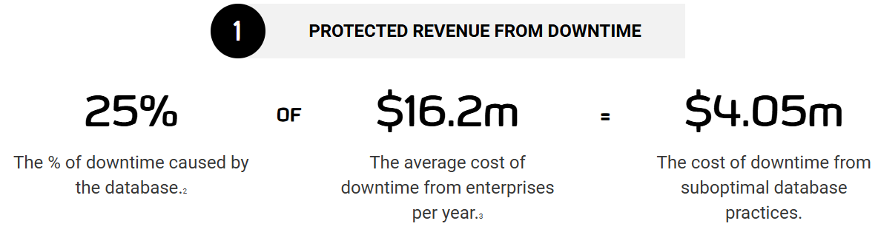
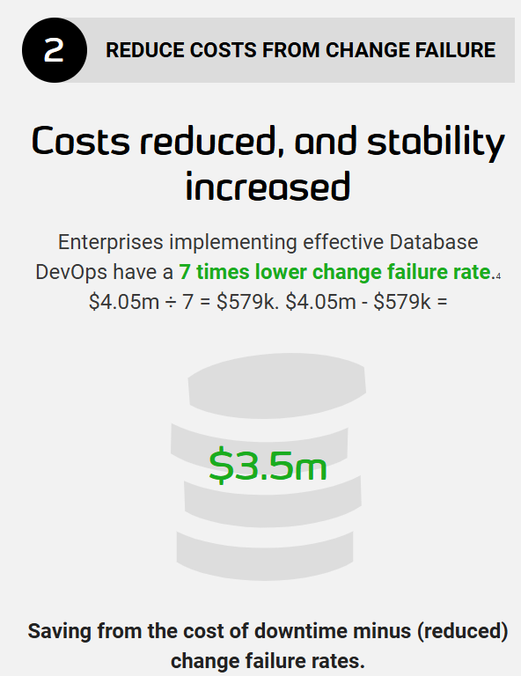

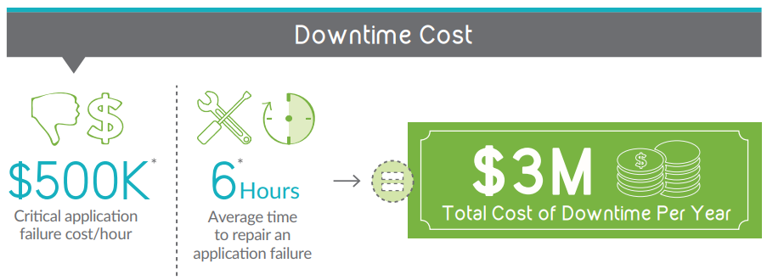

Database DevOps ROI
Notes:
Based on a survey by Redgate, average cost of downtime from enterprises per year: ~$16M, 25% of which is due to database = ~$4M average cost of downtime due to database per year
After implementing effective DB DevOps: 7 times lower failure rate = ~$3.5M SAVED per year on average – just on database failures.
Similar results in a survey by Dbmaestro: ~$3M SAVED per year on average.

Slide 19
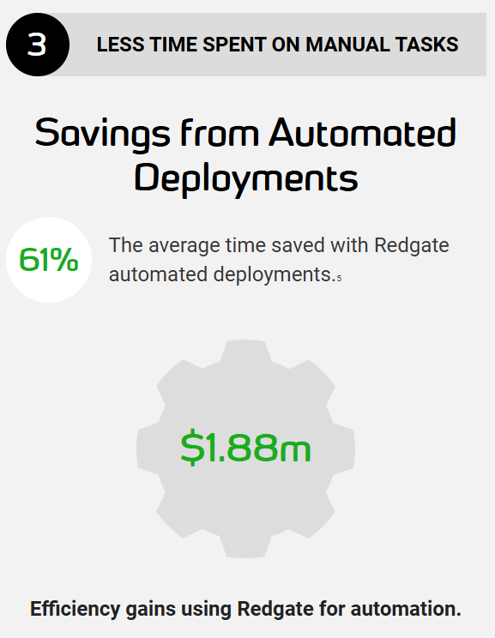
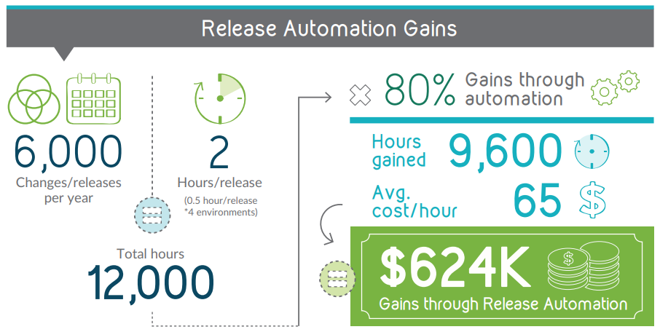
Database DevOps ROI
Notes:
Based on a survey by Dbmaestro, ~$624K saved per year on average thanks to automating database deployments alone.
Based on a survey by Redgate, ~$1.88M saved per year on average thanks to automating database deployments alone.

Slide 20
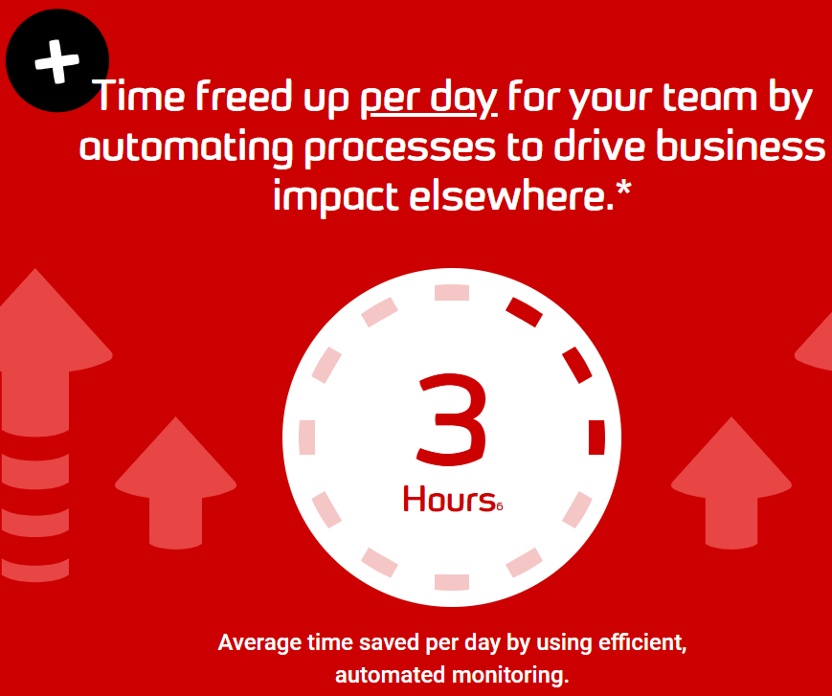
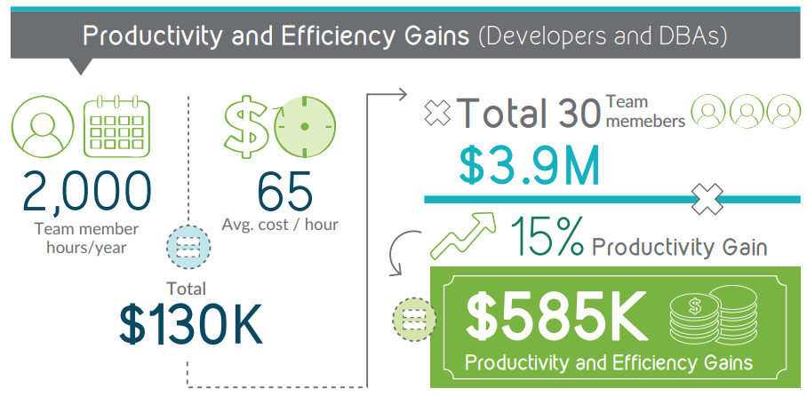

Database DevOps ROI
2,000 hours per year x $65 avg. cost/hour
x 30 team members
x 33% productivity gain = $1.29 M
Notes:
Thanks to effective database devops and monitoring, productivity gains for developers and DBAs resulted in ~$585K per year on average, based on Dbmaestro survey, i.e. 15% productivity gain.
And on average 3 hours per day based on a Redgate survey, i.e. 33% productivity gain.

Slide 21

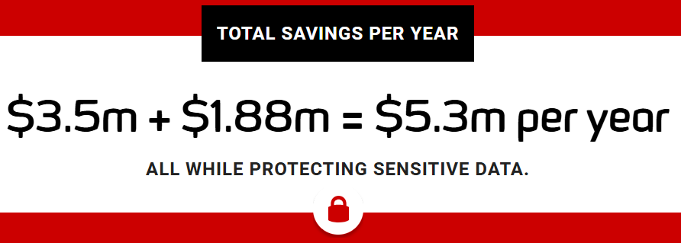
Database DevOps ROI
© DBmaestro, 2016
© Redgate, 2024
Notes:
In total, after taking in consideration including the costs of implementing DB DevOps:
Based on Dbmaestro survey: ~$4M on average per year.
Based on Redgate survey: ~$5M on average per year.
And now notice the year of each survey.
That means the results from that Dbmaestro survey should be viewed as modest compared to what they should be today.
Redgate’s results are actually much closer to modern times and their “inflated” numbers are more relevant.

Slide 22
Challenges of Database DevOps
Releasing DB changes is hard
With applications you can:
    Override configurations
    Reinstall from scratch
Databases, however, have:
    QA data
    DEV data
    PROD data
    “Delta” scripts (aka Change scripts, Incremental scripts)

Slide 23
Challenges of Database DevOps
In theory:
    State-based deployment
    Migration-based deployment
    “It just works”
In truth:
    Configuration drift
    Maintenance tasks
    Optimization tasks
    Collaboration overlap
    Potential data loss
Notes:
In theory, upgrading your database with SQL scripts just works; it’s true, the sum of every change to the database represented as a script is the final configuration. In practice, however, there’s usually something missing: a database configuration tends to drift. Someone performs a maintenance task, a performance optimization is implemented, or a different team’s work overlaps with your own. As a result, that script that worked in one environment might not work in the next, or worse—it ends up creating damage and downtime. Configuration drift can present itself as different schema configuration, different code, good code that was introduced by other teams, or plain production hotfixes, that might be blown away by the SQL script you are introducing. Therefore, working with just the change scripts is effectively a faithbased methodology. All the stars must be aligned 100% of the time for it to work.

Slide 24
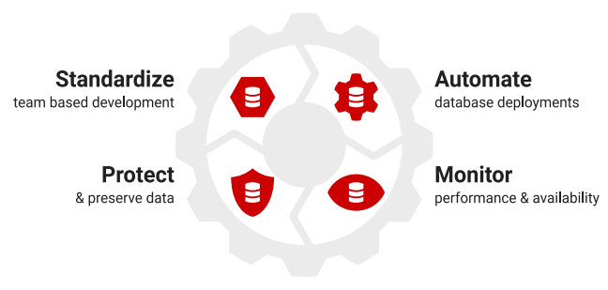

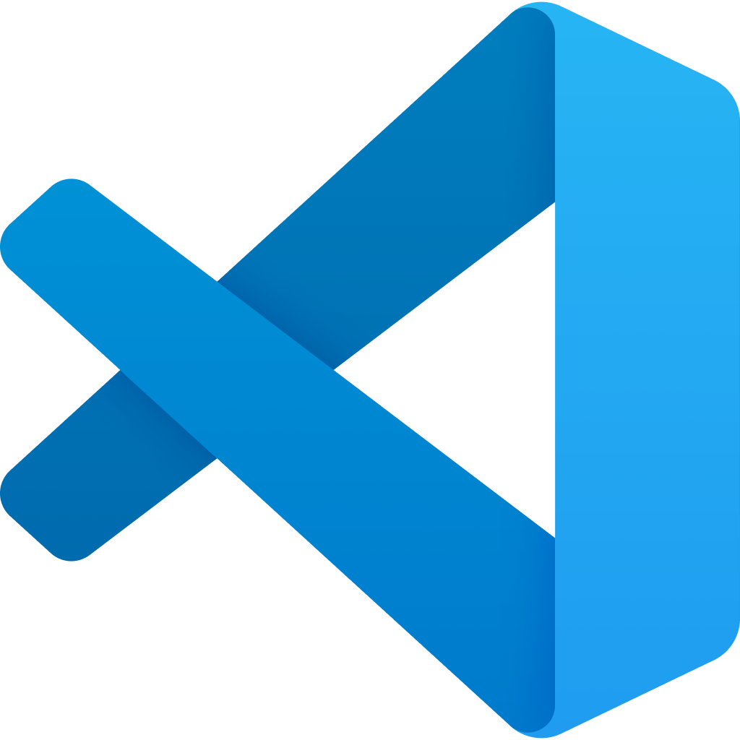

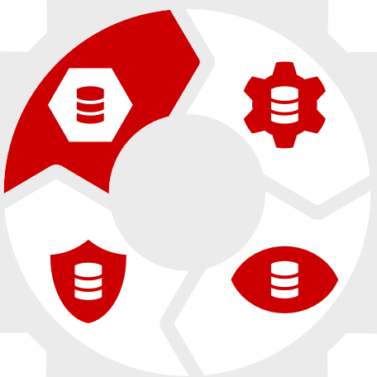
Implementing Database DevOps
1
Source: ROI of Database DevOps, Red-Gate
Notes:
So now that we have enough motivation to implement DB DevOps. How should we actually do it effectively?
Well, there’s a process of implementing several “key components”.
1. Standardize team-based development
Without the right processes or tooling in place, precious time is wasted on tedious rework.
Even a relatively easy innovation like introducing a tool to standardize the way database code is developed and formatted, and apply static code analysis as it is written can reap big rewards.
Code becomes shareable. Errors in code are highlighted immediately. Developers can add to or amend code written by other developers with ease. Legacy code remains understandable code.
Similarly, introducing version control into the process means teams can work on different branches at the same time, while maintaining a single source of truth from which a database can be built from the code in the repository at any time.

Slide 25

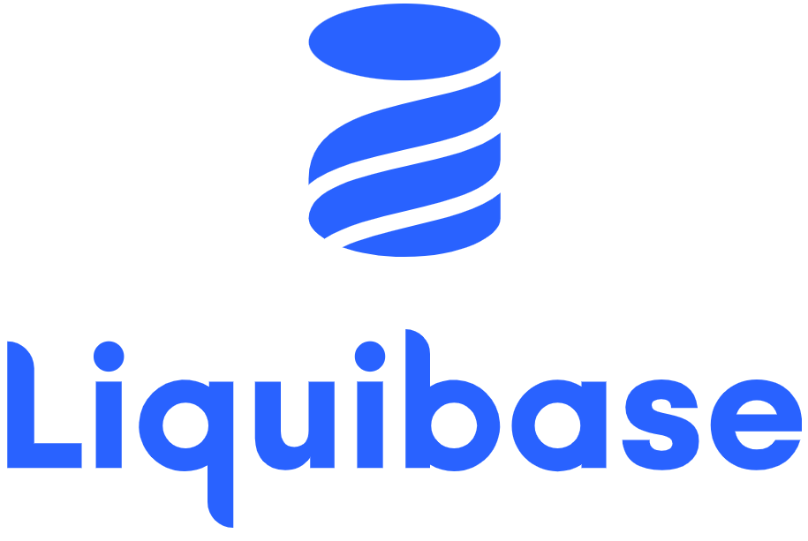
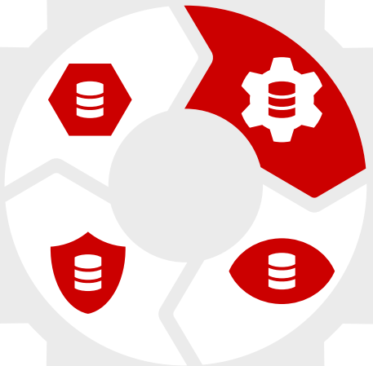
Implementing Database DevOps
1
2
“Build Once, Deploy Many”
Source: ROI of Database DevOps, Red-Gate
Notes:
2. Automate database deployments
Validating and testing code with an automated continuous integration process is becoming standard practice in application development, and it’s entering the database arena as well.
Each time a change is committed to version control, it triggers a process that builds the database and tests it to ensure the change is not a breaking change.
This draws attention to problems much earlier in development and prevents errors occurring later on.
The deployment process can also be made transparent and safe by automating change management tasks like the creation of deployment scripts, and freeing the development team up for more valuable work.
Importantly, with reliable, scalable, and repeatable processes in place for building, testing and releasing changes, companies can also embed security best practice, and achieve data protection by design and default

Slide 26
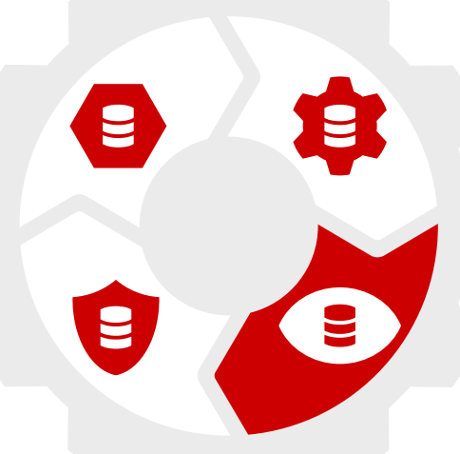



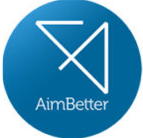
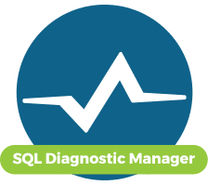
Implementing Database DevOps
1
2
3
Source: ROI of Database DevOps, Red-Gate
Notes:
3. Monitor performance and availability
While the automation which DevOps introduces to many parts of database development minimizes errors and gives much better visibility across the whole process, there is a flipside.
Instead of releasing changes to the database once or twice a quarter, changes can now be released at any time.
It is therefore important to monitor systems constantly to understand if releases are causing a problem so that they can be fixed quickly.
Performance monitoring will help by watching resource utilization (CPU, memory, I/O) changes over time, and determining the top ten or so worst performing queries, as well as responding to alerts about a drop in performance or an increase in deadlocks, and drilling down to the cause of the problem before it becomes an issue.
Monitoring for compliance also has a role to play by, for example, keeping track of failed logins and how many accounts are in the sysadmin group, as well as looking out for SQL injection attacks, changes in server and database settings, and modifications to permissions, users, and roles.

Slide 27
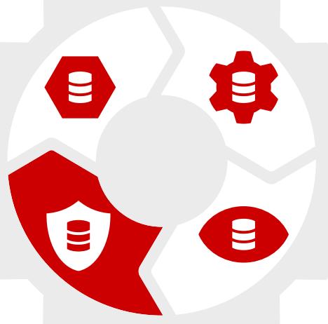



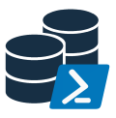
Implementing Database DevOps
1
2
4
3
Source: ROI of Database DevOps, Red-Gate
Notes:
4. Protect and preserve data
In database development, having an individual copy of the production database to test proposed changes against and ensure they are not breaking changes is the preferred way of working for many developers.
Those databases, however, contain the kind of personal data that needs to be protected to guard against data breaches.
Even when masked, the provisioning of frequently updated copies of the production database across development teams can, however, take up a lot of time, not to mention disk space.
This is where the tried and testing virtualization technology built into the Windows operating system can help.
There are now tools available which use the technology to create copies, or clones, of databases in seconds which, while only around 40MB in size for a 1TB database, work just like normal databases and can be connected to and edited using any program.
Used in conjunction with a masking tool, it means developers can work with copies of the production database which are truly representative of the original and retain the referential integrity and distribution characteristics.
The personal data inside them, however, is protected, and an audit trail can be provided which demonstrates compliance with any relevant legislation
Companies:
Red Gate
Dataprof
Delphix
Devart
DbaClone + DbaTools
And more

Slide 28
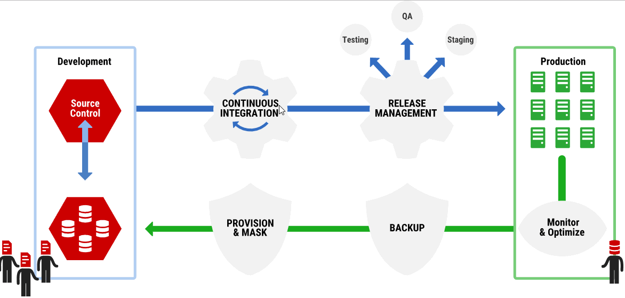
Database DevOps: The Full Picture
“Build Once, Deploy Many”
dev env
Source: The Database DevOps Challenges SQL Provision Solves, Redgate

Slide 29






Change Management: Leadership Alignment
Management
Productivity
Efficiency
Profitability
Communication
Feedback
“Sponsor(s)”
Developers
Notes:
Working from the bottom-up, an engagement would usually start at the level of the end user. New technology is often implemented to make an end user more efficient or productive. This impacts all levels of the hierarchy above and around the end user because the bottom line, in terms of profitability and productivity, is often tied to the success of the end user.
Another way to look at this is the top-down approach, which analyzes a change that starts at the executive level. Much of the reasoning for the change could be the same as it would be in a bottom-up approach (budgets, productivity, efficiency), but the way it is handled differs. In this approach, the decisions are usually made at the C-level, and regardless of the type of change in question, be it a change in org structure or business processes, the impacts of the change often trickle down across the organization.
It is important to check the pulse of the organization at various stages of the change to ensure that regardless of the approach, the pain points are being addressed organization-wide.
A great way to drive change across an organization is through sponsorship. Assigning sponsors across an organization, within different business units, regions, and job levels is a great way to raise awareness about change. This approach also establishes a sense of responsibility among the sponsors, who now have a vested interest in the program’s success. This network of sponsors should be engaged early and often, allowing them to be in sync with what changes are coming, and give individuals in different parts of the organization a point of contact for feedback and concerns that may arise as part of the impending change.

Slide 30

If You’re Not Racing, You’re Losing
Check out the rest of the series:
eitanblumin.com/cicd/
Notes:
In conclusion, DevOps in general, and Database DevOps specifically is first of all a team effort.
Everything needs to go smoothly and all parts must work smoothly with each other in order for it to be fast, safe, and reliable.
This is a race. And if you didn’t already realize that, then you’re already losing.
https://eitanblumin.com/cicd/
https://eitanblumin.com/project-type/ci-and-cd-with-ssdt/

Slide 31
Additional Resources
How to encourage DBAs to embrace DevOps, rather than fear change | Redgate
If You Don't Have Database Delivery Automation, Brace Yourself for These 10 Problems | DBmaestro
“Zero Downtime Database Deployments” - Alex Yates
“The Azure DevOps duet” - Kevin Chant and Sander Stad
Project-Oriented Offline Database Development - SQL Server Data Tools (SSDT) | Microsoft Learn
Case Study with ROI: BGL Insurance: Streamlining database deployments with Redgate (red-gate.com)
More resources are created every day!
Notes:
https://www.red-gate.com/blog/database-devops/how-to-encourage-dbas-to-embrace-devops-rather-than-fear-change
https://www.dbmaestro.com/blog/database-devops/database-delivery-automation
https://sqlfriday.net/past-sql-friday-sessions/sql-friday-12-alex-yates-on-zero-downtime-database-deployments/
https://sqlfriday.net/past-sql-friday-sessions/sql-friday-2-kevin-chant-and-sanders-stad-on-azure-devops-duet/
https://learn.microsoft.com/en-us/sql/ssdt/project-oriented-offline-database-development?view=sql-server-ver16
https://www.red-gate.com/products/flyway/case-studies/streamlining-database-deployments-with-redgate

Slide 32

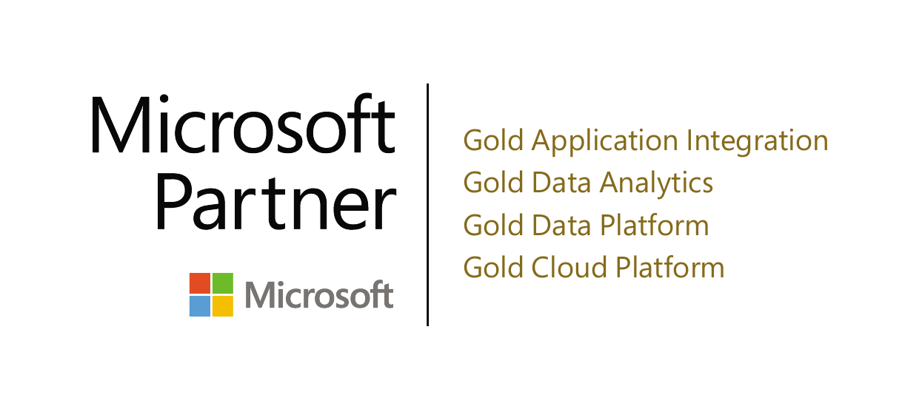
Thank you! (Time for questions)
Name: Eitan Blumin
Email: eitan@madeiradata.com
Blog: eitanblumin.com
Podcast: sqlserverradio.com | .co.il
Twitter: @EitanBlumin
LinkedIn: linkedin.com/in/eitanblumin
GitHub: github.com/MadeiraData
www.MadeiraData.com

