Slide 2
Copyright © 2023 Madeira Ltd
All Rights Reserved
Full rights, including copyrights, belong exclusively to Madeira Ltd
No use of the materials, in any form, is allowed,
unless receiving a prior written permission from Madeira Ltd

Slide 3
Eitan Blumin
Senior SQL Server Consultant
DBA Team Leader
Email: eitan@madeiradata.com
Twitter: @EitanBlumin
LinkedIn: linkedin.com/in/eitanblumin
Blog: EitanBlumin.com
Podcast: SqlServerRadio.co.il
SqlServerRadio.com
MadeiraData.com

Slide 4
What are we spending money on?
CPU Cores
RAM
Storage
Licensing
Network (?)
Graphics by:
Flat Icons
Nhor Phai
surang

Slide 5
What are we spending money on?
Network (?)
RAM
Licensing
CPU Cores
Storage
Graphics by:
Flat Icons
Nhor Phai
surang

Slide 6
What are we spending money on?
Licensing
RAM
CPU Cores
Network (?)
Storage
Graphics by:
Flat Icons
Nhor Phai
surang

Slide 7
Get ready… We’re about to get technical
CPU
cores
💵
Memory
Licensing

Slide 8
CPU+Memory
SOS Schedulers:
Numa 0
Numa 1
Numa 2
Numa 3
CPU Cores: (logical)
NUMA Nodes:
Memory Node 0
Memory Node 1
Memory Nodes:
Notes:
https://docs.microsoft.com/en-us/sql/relational-databases/thread-and-task-architecture-guide
The following definitions apply:
A thread or logical processor is one logical computing engine from the perspective of SQL Server, the operating system, an application, or a driver.
A core is a processor unit. It can consist of one or more logical processors.
A physical processor can consist of one or more cores. A physical processor is the same as a processor package or a socket.

Slide 9
CPU+Memory
SOS Schedulers:
Numa 0
Numa 1
Numa 2
Numa 3
CPU Cores: (logical)
NUMA Nodes:
Memory Node 0
Memory Node 1
Memory Nodes:
Notes:
https://docs.microsoft.com/en-us/sql/relational-databases/memory-management-architecture-guide#understanding-non-uniform-memory-access

Slide 10
CPU+Memory
SOS Schedulers:
Numa 0
Numa 1
CPU Cores: (logical)
NUMA Nodes:
Memory Node 0
Memory Node 1
Memory Nodes:
Notes:
https://docs.microsoft.com/en-us/sql/relational-databases/memory-management-architecture-guide#understanding-non-uniform-memory-access

Slide 11
CPU+Memory
SOS Schedulers:
Numa 0
Numa 1
CPU Cores: (logical)
NUMA Nodes:
Memory Node 0
Memory Nodes:
Notes:
https://docs.microsoft.com/en-us/sql/relational-databases/memory-management-architecture-guide#understanding-non-uniform-memory-access

Slide 12
CPU+Memory
SOS Schedulers:
Numa 0
CPU Cores: (logical)
NUMA Nodes:
Memory Node 0
Memory Nodes:
Notes:
https://docs.microsoft.com/en-us/sql/relational-databases/memory-management-architecture-guide#understanding-non-uniform-memory-access

Slide 13
CPU+Memory
SOS Schedulers:
Numa 0
Numa 1
Numa 2
Numa 3
CPU Cores: (logical)
NUMA Nodes:
Memory Node 0
Memory Node 1
Memory Nodes:
Notes:
https://docs.microsoft.com/en-us/sql/relational-databases/memory-management-architecture-guide#understanding-non-uniform-memory-access

Slide 14
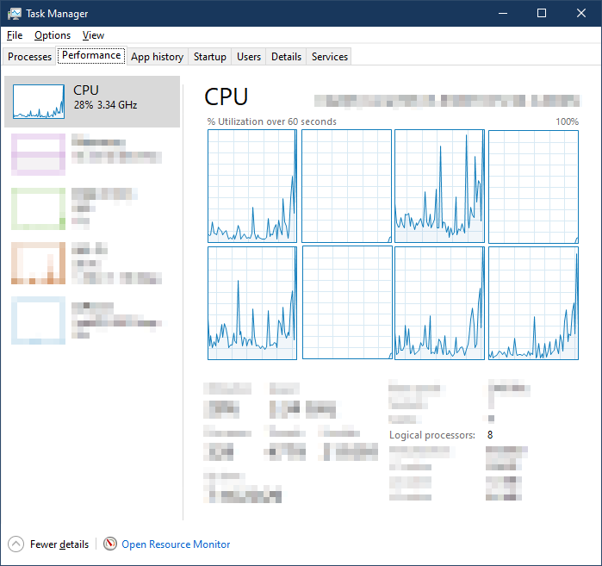
Offline Schedulers -> Unused CPU
zzz
zzz
SELECT N'Offline CPU schedulers found', COUNT(*) AS [value]
FROM sys.dm_os_schedulers WITH (NOLOCK)
WHERE ([is_online] = 0 OR [status] = N'VISIBLE OFFLINE')
and scheduler_id < 255
HAVING COUNT(*) > 0
zzz
Notes:
https://docs.microsoft.com/en-us/sql/relational-databases/memory-management-architecture-guide#understanding-non-uniform-memory-access

Slide 15
Unused CPU -> Unused Memory (NUMA)
Numa 0
Memory Node 0
SELECT 'Max server memory configured: '
+ CAST(c.[value] AS varchar(max))
+ ' MB (used memory on server: '
+ CAST(m.available_physical_memory_kb / 1024 AS varchar(max))
+ ' MB, total: '
+ CAST(m.total_physical_memory_kb / 1024 AS varchar(max))
+ ' MB)'
FROM sys.dm_os_sys_memory AS m, sys.configurations AS c
WHERE c.[name] = 'max server memory (MB)'
AND
available_physical_memory_kb >= 0.4 * total_physical_memory_kb

Slide 16
Unused Memory (‘max server memory’ configuration)
SELECT 'Max server memory configured: '
+ CAST([value] AS varchar(max))
+ ' MB (used memory on server: '
+ CAST(available_physical_memory_kb / 1024 AS varchar(max))
+ ' MB, total: '
+ CAST(total_physical_memory_kb / 1024 AS varchar(max))
+ ' MB)'
FROM sys.configurations AS c, sys.dm_os_sys_memory AS osmem
WHERE [name] = 'max server memory (MB)'
AND
available_physical_memory_kb >= 0.4 * total_physical_memory_kb
Max Memory Recommendation.sql
Notes:
https://github.com/MadeiraData/MadeiraToolbox/blob/master/Best Practices Checklists/Max Memory Recommendation.sql

Slide 17
Version/Edition Scale Limitations
Edition: | Standard |  | Web | Express
SQL Versions | CPU Cores | Max Memory | Max Memory | CPU Cores | Max Memory
2008 and older: | 4 sockets | Win. max | Win. max | 1 physical core | 1 GB
2008 R2: | 4 sockets | 64 GB | 64 GB | 1 physical core | 1 GB
2012: | lesser of 4 sockets or 16 physical cores | 64 GB | 64 GB | lesser of 1 socket or 4 physical cores | 1 GB
2014: | lesser of 4 sockets or 16 physical cores | 128 GB | 64 GB | lesser of 1 socket or 4 physical cores | 1 GB
2016 and newer: | lesser of 4 sockets or 24 physical cores | 128 GB | 64 GB | lesser of 1 socket or 4 physical cores | 1.4 GB
https://docs.microsoft.com/sql/sql-server/compute-capacity-limits-by-edition-of-sql-server
Notes:
In a virtualized environment, the compute capacity limit is based on the number of logical processors, not cores. The reason is that the processor architecture is not visible to the guest applications.
https://github.com/MadeiraData/MadeiraToolbox/blob/master/Best Practices Checklists/Server_Hardware_Underutilized.sql
https://www.sqlskills.com/blogs/glenn/upgrading-sql-server-day-6/
https://docs.microsoft.com/en-us/sql/sql-server/compute-capacity-limits-by-edition-of-sql-server?view=sql-server-ver15
https://docs.microsoft.com/en-us/previous-versions/sql/sql-server-2008-r2/cc645993(v=sql.105)#scalability-and-performance
https://docs.microsoft.com/en-us/previous-versions/sql/sql-server-2012/cc645993(v=sql.110)?redirectedfrom=MSDN#cross-box-scale-limits
https://docs.microsoft.com/en-us/previous-versions/sql/2014/getting-started/features-supported-by-the-editions-of-sql-server-2014?view=sql-server-2014#CrossBoxScale
https://docs.microsoft.com/en-us/sql/sql-server/editions-and-components-of-sql-server-2016?view=sql-server-ver15#Cross-BoxScaleLimits
https://docs.microsoft.com/en-us/sql/sql-server/editions-and-components-of-sql-server-2017?view=sql-server-ver15#Cross-BoxScaleLimits
https://docs.microsoft.com/en-us/sql/sql-server/editions-and-components-of-sql-server-version-15?view=sql-server-ver15#Cross-BoxScaleLimits
https://docs.microsoft.com/en-us/sql/linux/sql-server-linux-editions-and-components-2022?view=sql-server-ver16#scale-limits

Slide 18
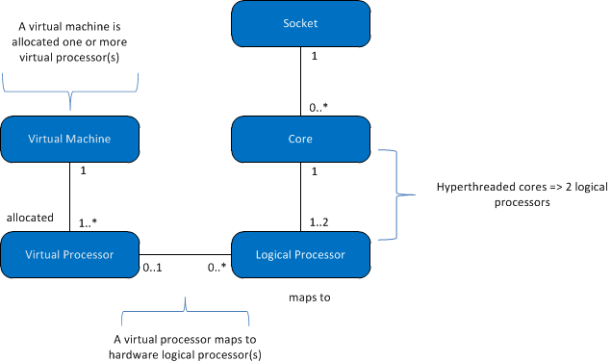
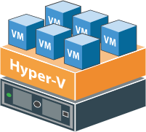
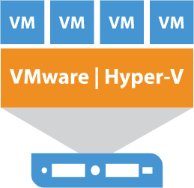
Version/Edition Scale Limitations
(in virtualization)
💵
💵
https://docs.microsoft.com/sql/sql-server
/compute-capacity-limits-by-edition-of-sql-server
Notes:
https://docs.microsoft.com/sql/sql-server/compute-capacity-limits-by-edition-of-sql-server
A virtual machine (VM) has one or more virtual processors.
One or more virtual processors are allocated to exactly one virtual machine.
Zero or one virtual processor is mapped to zero or more logical processors. When the mapping of virtual processors to logical processors is:
One to zero, it represents an unbound logical processor not used by the guest operating systems.
One to many, it represents an overcommit.
Zero to many, it represents the absence of virtual machine on the host system. So VMs don't use any logical processors.
A socket is mapped to zero or more cores. When the socket-to-core mapping is:
One to zero, it represents an empty socket. No chip is installed.
One to one, it represents a single-core chip installed in the socket. This mapping is rare these days.
One to many, it represents a multi-core chip installed in the socket. Typical values are 2, 4, and 8.
A core is mapped to one or two logical processors. When the mapping of cores to logical processors is:
One to one, hyperthreading is off.
One to two, hyperthreading is on.
The following definitions apply to the terms used in this article:
A thread or logical processor is one logical computing engine from the perspective of SQL Server, the operating system, an application, or a driver.
A core is a processor unit. It can consist of one or more logical processors.
A physical processor can consist of one or more cores. A physical processor is the same as a processor package or a socket.

Slide 19
Underutilized CPU and Memory
Summary:
Max server memory configuration
Offline SOS Schedulers
Hardware issues
Unused CPU Cores
SOS Scheduler issues
Edition / Licensing / Virtualization issues
Hard/Soft-NUMA config. issues
zzz
Leads to:
Wasted Core-based licensing costs
Wasted Core-based hardware costs
Unused and wasted memory (NUMA)
Notes:
Summary of common causes for wasted money

Slide 20
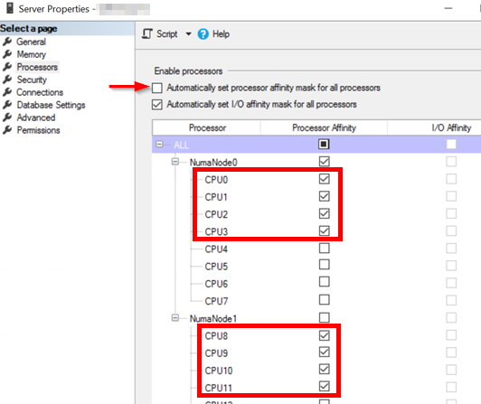
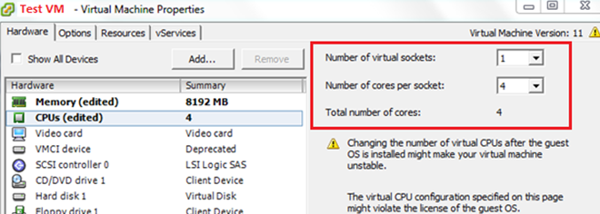
Underutilized CPU and Memory
Remediation:
Set “max server memory” to proper value.
Use Affinity Mask to evenly-distribute active processors across NUMA nodes.
Fix virtualization-level processor / socket settings to match SQL Server license limits.
Up/downgrade your license?
Up/downgrade your server?
Notes:
https://www.techiessphere.com/2016/02/how-to-choose-right-number-of-virtual.html
https://docs.microsoft.com/en-us/sql/database-engine/configure-windows/soft-numa-sql-server#manual-soft-numa
https://github.com/MadeiraData/MadeiraToolbox/blob/master/Utility%20Scripts/Balance%20CPU%20Cores%20Across%20NUMA%20Nodes.sql
https://www.mssqltips.com/sqlservertip/4801/sql-server-does-not-use-all-assigned-cpus-on-vm/

Slide 21
The Power of a CPU…
…does not affect the Licensing cost…
…except when you do not utilize the CPU.
If we upgrade CPU Gen:
Same licensing cost per core
Somewhat more expensive hardware
More power for the buck
GenX cores
vs
Gen(X+n) cores
Notes:
Instead of adding more cores and paying more for both hardware and licensing:
Simply upgrade the core version/generation and enjoy better performance without added licensing.
Also consider reducing the number of cores to stay at same performance level but pay less for licensing.

Slide 22
More on Licensing
Enterprise features in Standard Edition
SQL Server 2016 SP1
Table Partitioning
Data Compression
Columnstore Indexes
In-Memory OLTP
And more!
SQL Server 2019
Transparent Data Encryption (TDE)
Always Encrypted with Secured Enclaves
Extensible Key Management (EKM)
Potential for:
Version Upgrade
+
Edition Downgrade
?
Notes:
https://www.littlekendra.com/2016/11/16/sql-server-2016-sp1-features-added-to-standard-web-express-local-db-editions/
https://straightpathsql.com/archives/2020/12/sql-server-should-i-move-from-enterprise-to-standard/

Slide 23
More on Licensing
Free Licensing for Passive HA/DR instances (VM and Managed Instances)
with SA (Software Assurance)
PRIMARY
SECONDARY (DR)
💵
💵
💵
Notes:
https://cloudblogs.microsoft.com/sqlserver/2019/10/30/new-high-availability-and-disaster-recovery-benefits-for-sql-server/
https://cloudblogs.microsoft.com/sqlserver/2022/11/16/new-sql-server-on-azure-virtual-machines-and-azure-sql-managed-instance-dr-benefits/

Slide 24
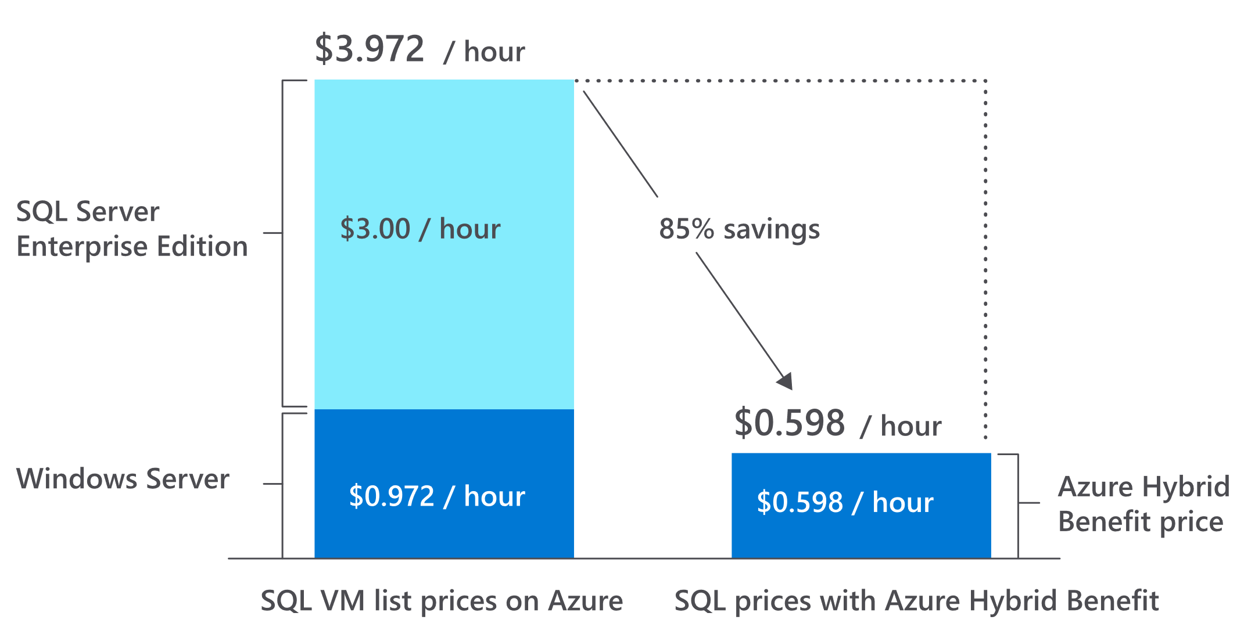
More on Licensing
Azure Cloud
Dev/Test subscriptions
Hybrid Benefit
Reserved Instances (Reservations)
https://azure.microsoft.com/blog/reserved-instances-now-applicable-to-classic-vms-cloud-services-and-dev-test-subscriptions
Notes:
https://azure.microsoft.com/en-us/pricing/dev-test/
https://azure.microsoft.com/en-us/pricing/hybrid-benefit/
https://docs.microsoft.com/en-us/azure/cost-management-billing/reservations/save-compute-costs-reservations
https://azure.microsoft.com/blog/reserved-instances-now-applicable-to-classic-vms-cloud-services-and-dev-test-subscriptions

Slide 25
Cloud Network Bandwidth

Slide 26
Cloud Network Bandwidth
💵
💵
👍
💵
https://azure.microsoft.com/pricing/details/bandwidth
Notes:
https://docs.microsoft.com/en-us/azure/availability-zones/az-overview

Slide 27
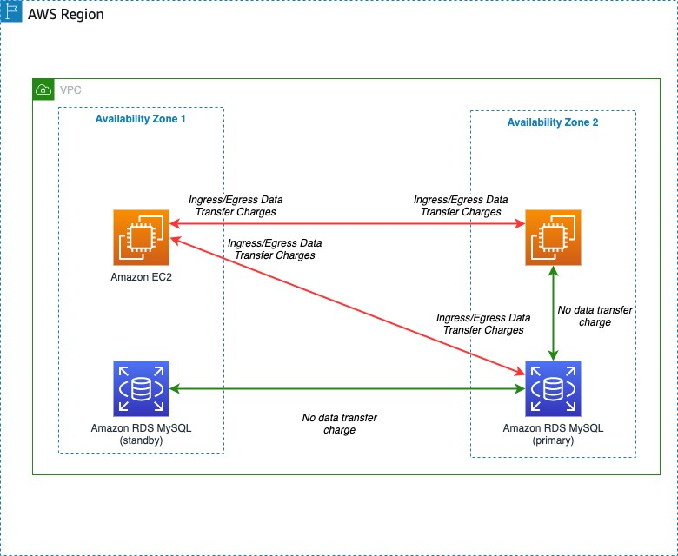
Cloud Network Bandwidth
💵
💵
💵
💵
👍
👍
💵
👍
https://aws.amazon.com/blogs/architecture/overview-of-data-transfer-costs-for-common-architectures/
https://azure.microsoft.com/pricing/details/bandwidth
Notes:
https://aws.amazon.com/blogs/architecture/overview-of-data-transfer-costs-for-common-architectures/

Slide 28
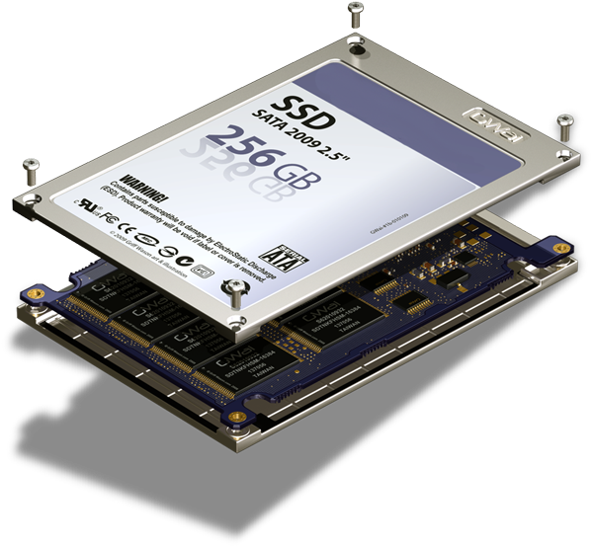
Storage
Underutilized Storage
Over-utilized Storage
Storage Pricing
This Photo by Unknown Author is licensed under CC BY-NC

Slide 29
Underutilized Storage
Deletion
Archiving
Migration
Consolidation
Expand + Contract
Data Compression
Image by Those Icons

Slide 30
DETECTION of Underutilized Storage
SELECT
vs.volume_mount_point
, disk_total_mb
, disk_free_mb
, unused_database_mb = SUM(unused_db_mb)
, unused_total_mb = SUM(unused_db_mb) + calculations.disk_free_mb
, unused_total_percent = (SUM(unused_db_mb) + calculations.disk_free_mb) / calculations.disk_total_mb * 100
FROM sys.database_files AS f
CROSS APPLY sys.dm_os_volume_stats (DB_ID(), f.file_id) AS vs
CROSS APPLY (SELECT
disk_total_mb = vs.total_bytes / 1024 / 1024
, disk_free_mb = vs.available_bytes / 1024 / 1024
, unused_db_mb = ISNULL(f.size-FILEPROPERTY(f.[name], 'SpaceUsed'),0) /128.0
) AS calculations
WHERE f.type IN (0,1)
GROUP BY
vs.volume_mount_point
, calculations.disk_total_mb
, calculations.disk_free_mb
(for each DB)
Server_Hardware_Underutilized.sql

Slide 31
REMEDIATION of Underutilized Storage
Shrink files (carefully)
Consolidate files (carefully)
Resize / Detach disks (carefully!!!)
Image by Those Icons
Notes:
https://eitanblumin.com/2020/04/07/troubleshooting-long-running-shrink-operations/

Slide 32
Over-Utilized Storage
Steady data growth over time, reaching towards resource exhaustion.

Slide 33
REMEDIATION of Over-Utilized Storage
Delete / archive unnecessary data
Apply data compression (where possible)
COLUMNSTORE_ARCHIVE is incredible 🤩
Consolidate files (carefully) – esp. if size cost is non-linear
Add Storage (may be cheaper than human effort)
Business / Organization Policy may vary
Image by Those Icons
Notes:
https://eitanblumin.com/2020/02/18/ultimate-compression-savings-estimation-script-entire-database/

Slide 34
Storage Pricing
Expensive NAS / SAN machines
The disks themselves are very cheap
Size to IOPS/Throughput ratio
Control throughput and size independently
Azure: Performance tiers for managed disks (⚠)
AWS: gp3
Image by Those Icons
Notes:
Performance tiers for managed disks in Azure incur costs equal to the disk cost if it was resized to the relevant size tier. Therefore, it should only be done temporarily. The benefit is that this way, performance can be scaled up and down without downtime.

Slide 35
Resources
github.com/MadeiraData/MadeiraToolbox
/Best Practices Checklists/
Server Hardware Underutilized.sql
Max Memory Recommendation.sql
/Health Check Scripts/
NUMA Node Imbalance Detection.sql
/Utility Scripts/
Balance CPU Cores Across NUMA Nodes.sql
Ultimate Compression Savings Estimation Script.sql
Notes:
https://eitanblumin.com/2020/04/07/troubleshooting-long-running-shrink-operations/
https://github.com/MadeiraData/MadeiraToolbox/blob/master/Best Practices Checklists/Server_Hardware_Underutilized.sql
https://github.com/MadeiraData/MadeiraToolbox/blob/master/Best Practices Checklists/Max Memory Recommendation.sql
https://github.com/MadeiraData/MadeiraToolbox/blob/master/Health Check Scripts/Soft-NUMA Node Imbalance Detection.sql
https://github.com/MadeiraData/MadeiraToolbox/blob/master/Utility Scripts/ultimate_compression_savings_estimation_whole_database.sql

Slide 36
Time for Q&A
Name: Eitan Blumin
Email Address: eitan@madeiradata.com
Twitter: @EitanBlumin
LinkedIn: linkedin.com/in/eitanblumin
Blog: EitanBlumin.com
Podcast: SqlServerRadio.co.il |SqlServerRadio.com
GitHub: GitHub.com/MadeiraData |GitHub.com/EitanBlumin
MadeiraData.com
Image courtesy of Mister GC / FreeDigitalPhotos.net

