Slide 1
Troubleshooting Common SSDT Errors
By Eitan Blumin
Background by Dirk Wouters / Pixabay

Slide 2
Copyright © 2023 Madeira Ltd
All Rights Reserved
Full rights, including copyrights, belong exclusively to Madeira Ltd
No use of the materials, in any form, is allowed,
unless receiving a prior written permission from Madeira Ltd
Background by Dirk Wouters / Pixabay

Slide 3
About Me…
Name: Eitan Blumin
Email: eitan@madeiradata.com
Blog: eitanblumin.com
Podcast: sqlserverradio.com
Twitter: @EitanBlumin
LinkedIn: linkedin.com/in/eitanblumin
MadeiraData.com
Notes:
Q: How to reach me?
Q: Where to find more resources? (blog)

Slide 4
Troubleshooting Common SSDT Errors for SQL Server DevOps
What is this about?
Who is it for?
Notes:
Refer to part 1: Development Lifecycle Basics for DBAs as prerequisite
Part 2: SSDT Methodologies for SQL Server DevOps
Part 3: SSDT Tools & Features for SQL Server DevOps

Slide 5
Agenda
Zero-Downtime Deployment Development
Cross-Database Dependencies
Common Build Issues
Common Edge Cases
Replication
Cyclical Reference
Table Partitioning
Idempotent/Dynamic Deployments
SQL-CLR
Troubleshooting SSDT Deployments

Slide 6
Zero-Downtime Deployment Development
Incremental Schema Changes
Feature Toggles
“Low” Environments:
Dev\Test, QA
Staging
UAT – User Acceptance Tests (Alpha/Beta/Preview versions)
Remember: Repetition builds trust!
https://sqlfriday.net/past-sql-friday-sessions/sql-friday-12-alex-yates-on-zero-downtime-database-deployments/

Slide 7
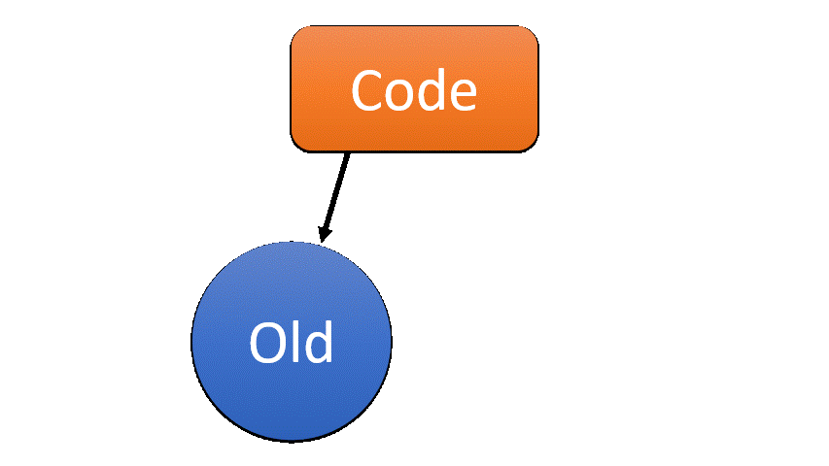
Incremental Schema Changes
Zero-Downtime Deployment Development
Expand + Contract
Maintaining column order
New columns: at end of list, and nullable
Maintaining order of procedure parameters
New parameters: with default values
Function headers: must be unchanged (or create new function)
Refactor Tool
Renaming objects and columns
Changing schemas
Be mindful about dependent objects

Slide 8
Feature Toggles
Zero-Downtime Deployment Development
CREATE PROC_MainProcedure1
@NewFeatureEnabled bit = 1
AS
SET @NewFeatureEnabled = CASE
WHEN ABS(CHECKSUM(NEWID())) % 100 < 30
THEN 1 ELSE 0 END
Feature Flags / Toggles
Code-Driven
Percent Toggle / Canary Release
Data-driven toggles
SELECT @NewFeatureEnabled = ParamValue
FROM dbo.tblGlobalParams
WHERE ParamName = 'NewFeatureEnabled'
IF @NewFeatureEnabled = 1
BEGIN
EXEC dbo.PROC_SubProcedure1_New
END
ELSE
BEGIN
EXEC dbo.PROC_SubProcedure1
END
https://martinfowler.com/bliki/FeatureToggle.html
https://martinfowler.com/bliki/CanaryRelease.html

Slide 9
Cross-Database Dependencies
Build errors due to reference errors?
Cross-database references (3-part names)
[$(OtherDB)].[dbo].[MyTable]
Cross-server references (4-part names)
[$(OtherServer)].[$(OtherDB)].[dbo].[MyTable]
Self-reference (3-part name in same database)
[$(DatabaseName)].[dbo].[MyTable]
[dbo].[MyTable]
System objects / system database references
master / msdb database references
Pay attention to compatibility level

Slide 10
Common Build Issues
Object reference errors
Reference errors to other databases
Add both databases to solution
Same .NET framework version
Same database compatibility
Re-create database references.
Unsupported object types
Pre-Deployment and Post-Deployment scripts
Static Data (sp_generate_merge)
SQL Agent Jobs (azdo-sql-server-dba)
Existence check
Job owner

Slide 11
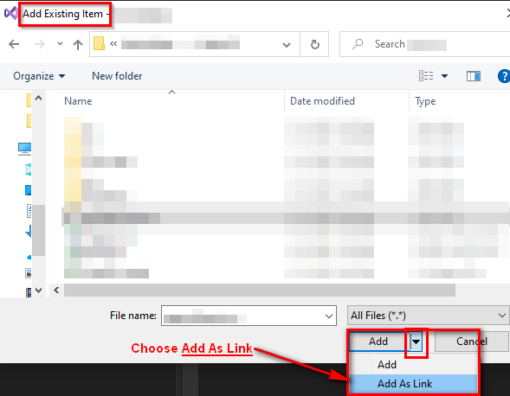
Replication (Subscriber / Publisher)
Maintain single-source-of-truth
Same-database reference
Subscriber -> Publisher
Subscriber -> MIDDLE <- Publisher
Add as Link
Modular
Reference
replicated objects
Modular
Reference
publisher
subscriber
Direct
Reference
Subscriber-specific
objects can still
be added in separate
SQL files

Slide 12
Cyclical Database References
Split to separate “modular” database projects
Add Same-Database References
same-database
reference
DB1
DB2
DB1
cross-database
references
incremental
deployment-only
Build&Deploy order:
DB2
DB1
DB2_dependencies
cross-database
references
DB2
DB2_dependencies

Slide 13
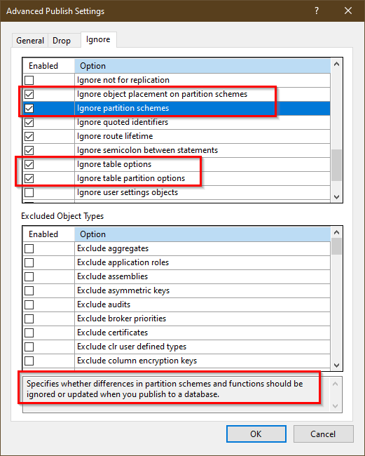
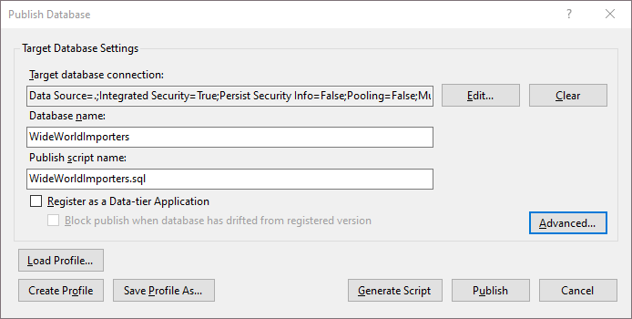
Partition Functions and Schemes
Publish profiles

Slide 14
Idempotent Data Deployments
DECLARE @Changesets AS TABLE (ChangesetID int, Command nvarchar(MAX))
INSERT INTO @Changesets (ChangesetID, Command)
VALUES
(1,N'EXEC Marcaille.dbo.PROC_EnableChangeset1')
,(2,N'UPDATE Versai.dbo.Tenants SET SaleDays = 40 WHERE RegistrationDate < ''2022-07-02''')
,(3,N'DELETE FROM Caprice.dbo.ServiceTypes WHERE ServiceId = 4')
DECLARE @CID int, @CMD nvarchar(MAX)
DECLARE Changesets CURSOR
LOCAL FAST_FORWARD
FOR
SELECT ChangesetID, Command FROM @Changesets
WHERE ChangesetID > ISNULL((SELECT MAX(LastAppliedChangesetID) FROM dbo.__Versioning), 0)
ORDER BY ChangesetID ASC
OPEN Changesets
WHILE 1=1
BEGIN
FETCH NEXT FROM Changesets INTO @CID, @CMD
IF @@FETCH_STATUS <> 0 BREAK;
EXEC(@CMD);
UPDATE dbo.__Versioning SET LastAppliedChangesetID = @CID
END
CLOSE Changesets
DEALLOCATE Changesets
Post-Deployment Script
Execute once
Data-driven
Minimal objects required
Easy to maintain
Easy to track

Slide 15
Dynamic SQLCMD Deployments
/*
Post-Deployment Script Template
--------------------------------------------------------------------------------------
This file contains SQL statements that will be appended to the build script.
Use SQLCMD syntax to include a file in the post-deployment script.
Example: :r .\myfile.sql
Use SQLCMD syntax to reference a variable in the post-deployment script.
Example: :setvar TableName MyTable
SELECT * FROM [$(TableName)]
--------------------------------------------------------------------------------------
*/
IF '$(DeployJobs)' = 'True'
BEGIN
:r .\PostDeployments.Jobs.sql
END
GO
IF '$(DeployChangeset8)' = 'True'
BEGIN
:r .\PostDeployments.Changeset8.sql
END
GO
Notes:
Different SQLCMD values can be set at deployment-time per target

Slide 16
SQL-CLR Digital Signing
TRUSTWORTHY database setting
Digital assembly signing
Digitally sign your SSDT project
Create master key in SQL Server
Create asymmetric key from .dll file
Create LOGIN from asymmetric key
GRANT UNSAFE / EXTERNAL ACCESS ASSEMBLY
Instance configurations
clr enabled
clr strict security (SQL 2019 +)
signed .dll file
master
master key
asymmetric key
login from key +
GRANT ASSEMBLY
Create Assembly
https://github.com/MadeiraData/MadeiraToolbox/blob/master/ Utility%20Scripts/Script.PreDeployment.CLR_Signing.sql
https://www.sommarskog.se/grantperm.html
Notes:
Q: What is the TRUSTWORTHY database setting? (don’t go too much into details due to time)
Q: What would happen if the relevant clr instance configurations would be turned off/on?

Slide 17
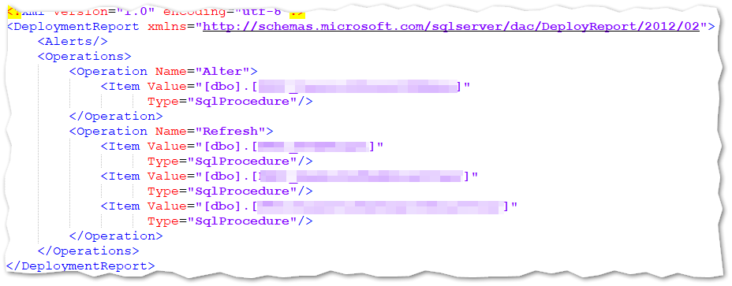
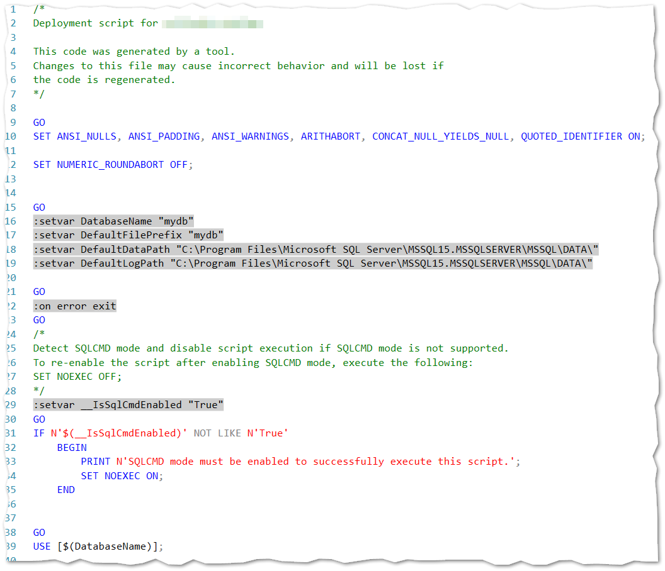
Troubleshooting SSDT Deployments
The Publish Script
SqlPackage.exe /Action:Script
The Deployment Report
Powershell (DbaTools)
Shallow waters, baby steps:
Start with Local
Start with Manual
https://github.com/MadeiraData/MadeiraToolbox/blob/master/Utility%20Scripts/Deploy_DACPAC_DbaTools.ps1
Notes:
Q: How can we troubleshoot failing deployments, or proactively prepare for deployment errors and issues?
Call back to building trust with the artifact via multiple deployments to lower environments

Slide 18
Abnormal Edge Cases
Some abnormal deployment use cases may be easier to implement using traditional, manual migration scripts, rather than working around SSDT limitations.
SSDT would still be ideal for common daily development.
1
Manual Deployment
DBA
Production
2
Desired State
SSDT Source Control
3
CI/CD (no effect)
Notes:
Q: What to do when the effort required to deploy a change (traditionally) via SSDT is too great?

Slide 19
Additional Resources
“Zero Downtime Database Deployments” - Alex Yates
Architecting Zero Downtime Deployments – Steve Jones
github.com/readyroll/generate-sql-merge
github.com/avolok/azdo-sql-server-dba
github.com/MadeiraData/MadeiraToolbox
dbatools.io
docs.microsoft.com/sql/ssdt/project-oriented-offline-database-development
docs.microsoft.com/sql/tools/sqlpackage

Slide 20
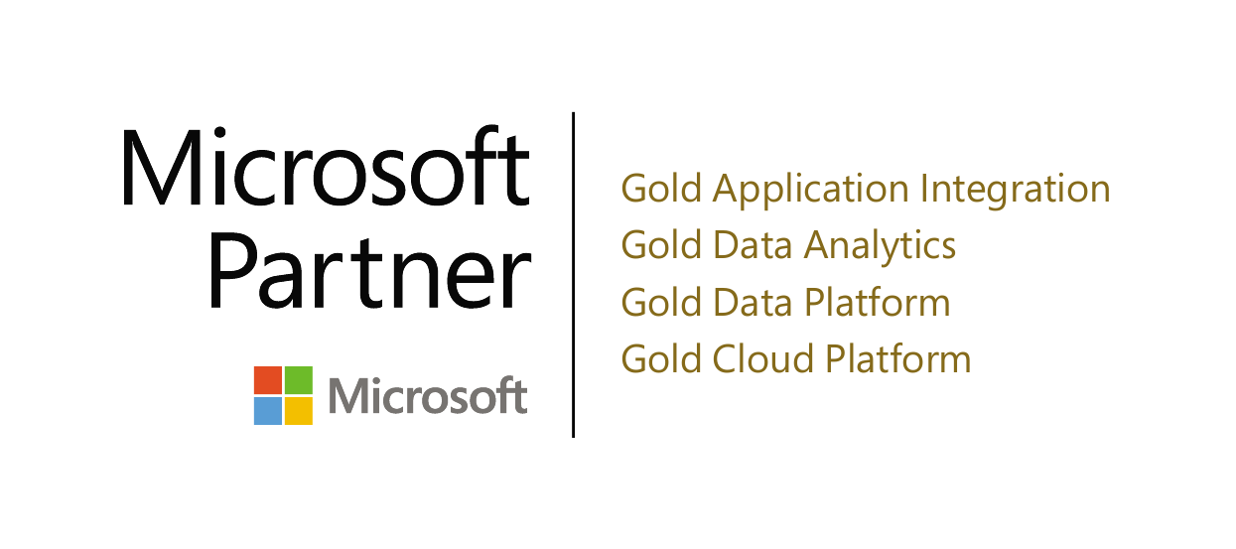
Thank you! (Time for questions)
Name: Eitan Blumin
Email: eitan@madeiradata.com
Blog: eitanblumin.com
Podcast: sqlserverradio.com
Twitter: @EitanBlumin
LinkedIn: linkedin.com/in/eitanblumin
GitHub: github.com/MadeiraData
github.com/EitanBlumin
www.madeiradata.com

