Slide 1
SQL Server 2022
Contained Availability Groups

Slide 2
Copyright © 2022 Madeira Ltd
All Rights Reserved
Full rights, including copyrights, belong exclusively to Madeira Ltd
No use of the materials, in any form, is allowed,
unless receiving a prior written permission from Madeira Ltd

Slide 3
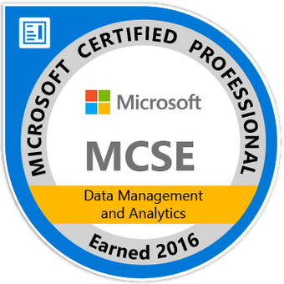
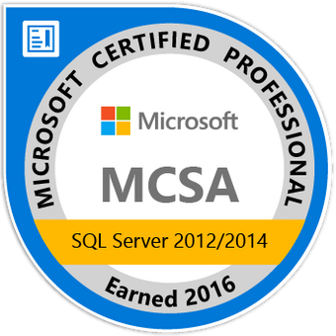
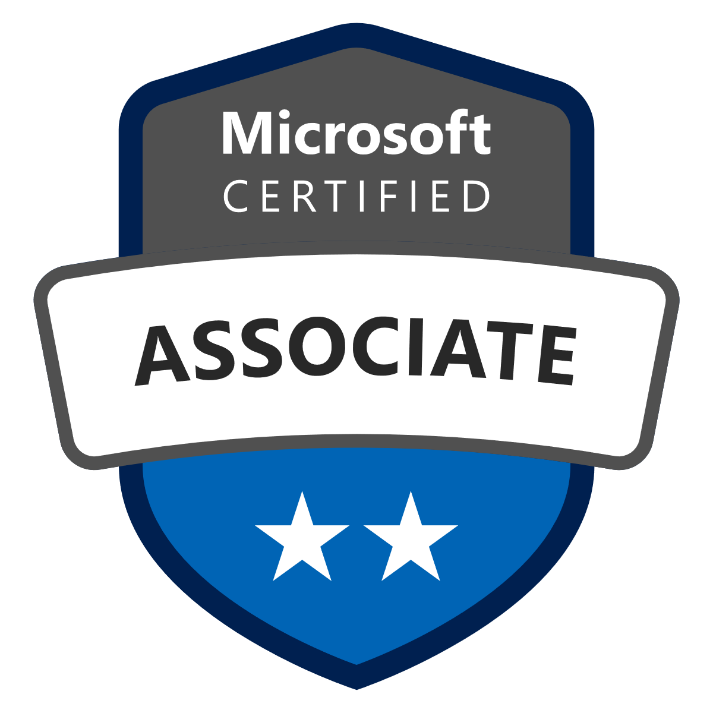
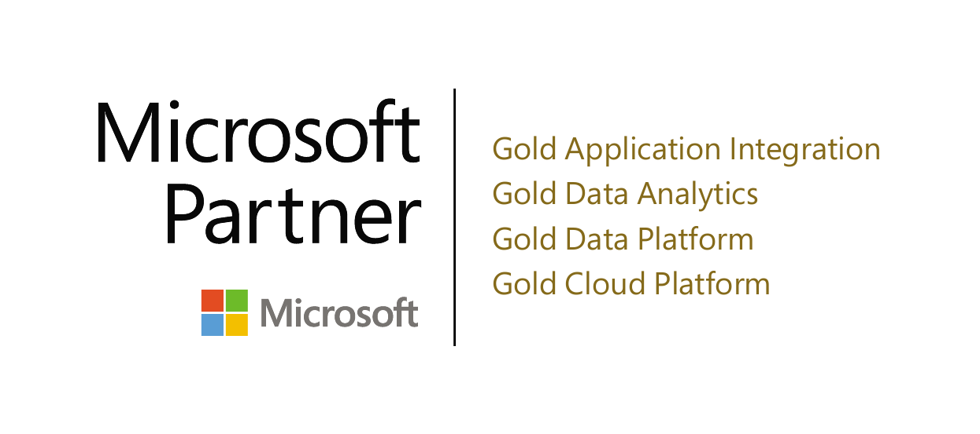
Eitan Blumin
Senior SQL Server Consultant
DBA Team Leader
Email: eitan@madeiradata.com
Twitter: @EitanBlumin
LinkedIn: linkedin.com/in/eitanblumin
Blog: EitanBlumin.com
MadeiraData.com
Podcast: SqlServerRadio.co.il
SqlServerRadio.com

Slide 4
Contained Availability Groups
Disclaimer: Everything in this session is relevant to SQL Server CTP 2.0 but may not necessarily be true for the GA/RTM version of SQL Server 2022, and/or for newer versions of SQL Server that may be released in the future.
2022

Slide 5
Before SQL Server 2022
bit.ly/HADRMyJobs
Jobs
Logins
Login permissions
Linked Servers
Anything in MSDB
Anything in MASTER

Slide 6
Contained Availability Group
MyAG1
2022

Slide 7
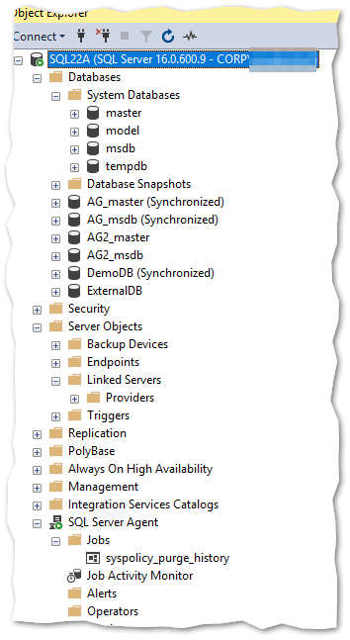
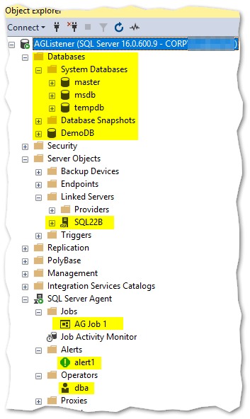
Contained Connectivity
connecting regularly to a non-containedAG database
connecting to a contained AG listener or database

Slide 8
It’s like VR!
Notes:
It’s like logging into a virtual world!

Slide 9
SSMS Changes (19.x)
2022

Slide 10
T-SQL Changes
2022
Notes:
REUSE_SYSTEM_DATABASES is an optional flag indicating whether you’d want to reuse previously created master+msdb databases, if they already exist with identical names.

Slide 11
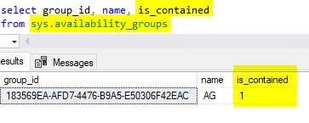
DMV Changes
2022

Slide 12
Supported Interoperability
Change Data Capture (CDC)
Log Shipping (Primary)
Transparent Data Encryption (TDE)
2022

Slide 13
Not Supported Interoperability
Replication (all types)
Log Shipping (Secondary)
Distributed Availability Groups
2022

Slide 14
Upon Creation of Contained AG
Sysadmin Logins in instance-level master are copied to the Contained AG master
What about other logins?
How login authentication works?
-> instance-level master -> login SID
Connection point
=
Authentication point
(no inheritance!)
-> contained-AG master -> login SID
github.com/MadeiraData/MadeiraToolbox/Utility%20Scripts/sp_GetSrvPermissions.sql
Notes:
QUESTIONNAIRE OPPORTUNITY
Upon creation of a contained AG, all sysadmin logins are automatically copied into the contained master database.
But that’s about it. Everything else will need to be copied/recreated manually.
What happens if:
You connect using a non-contained login into the AG?
You connect using a contained login into a database outside the AG?
The same login exists as contained and non-contained?
A: Based on the connection point -> authenticate based on relevant master -> get authenticated login SID

Slide 15
USE and 3-part names
User databases outside the AG
Contained MSDB and Master
Non-contained MSDB and Master
Notes:
QUESTIONNAIRE OPPORTUNITY
After you connect to a contained AG:
All references to msdb and master go to the contained AG system databases (including USE and 3-part names)
Accessing the “instance-level” system databases becomes impossible.
If your login has permissions (based on its SID), you’re still able to access user databases external to the AG, and it doesn’t take you out of the “context” of the contained AG
This is based on SID, so it automatically affects Windows Auth logins, but not necessarily SQL Auth logins

Slide 16
Connecting to Contained AG vs connecting to the “global” Instance
When connected to contained AG, users will only see databases in the contained AG, plus tempdb.
At instance level, contained AG master and msdb names will be [contained AG]_master, and [contained AG]_msdb. Inside contained AG, their names are master and msdb.
Database ID for contained AG master is 1 from inside contained AG, but something else when connected to the instance. [same is NOT TRUE for msdb]
While users will not see databases outside of the contained AG in sys.databases when connected in a contained AG connection, they will be able to access those databases by 4-part name or through the use command [based on SID].
Server configurations can be read from contained AG connection but can only be written from instance level.
From contained AG connections, sysadmin can perform instance level operations, such as shutting down SQL Server.
Most instance level, DB level, end point level, or AG level configuration changes can only be performed from instance-level connections, not contained AG connections.

Slide 17
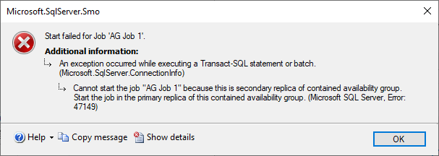
Contained AG Jobs
Jobs execute on the PRIMARY replica.
That’s it.
Yes, even if you have a readable secondary.
Because the contained msdb is not writeable.
bit.ly/HADRMyJobs
Notes:
QUESTIONNAIRE OPPORTUNITY

Slide 18
Contained AG Does NOT:
Allow contained jobs to run on secondary replicas
Automatically synchronize instance-level objects to contained AG-level objects and vice-versa
Synchronize instance-level objects across multiple [contained] Availability Groups
Affect objects outside SQL Server:
Application/backend services
Files used by app/backend
Environment variables
Firewall rules
Notes:
QUESTIONNAIRE OPPORTUNITY

Slide 19
Current Alternatives
https://bit.ly/HADRMyJobs
https://dbatools.io
Separate between SQL Server and other components (use other availability options suitable for the need)
Policy Management at the Windows/Domain level

Slide 20
Other Availability Improvements
Link to Azure SQL Managed Instance | Connect your SQL Server instance to Azure SQL Managed Instance. See Link feature for Azure SQL Managed Instance (preview).
Distributed availability group | Changing REQUIRED_SYNCHRONIZED_SECONDARIES_TO_COMMIT is supported. For more information, visit ALTER AVAILABILITY GROUP (Transact-SQL) Now using multiple TCP connections for better network bandwidth utilization across a remote link with long tcp latencies.
Improved availability groups | ParallelRedoThreadPool : Instance level thread pool shared with all databases having redo work. With this, each database can take the benefit of parallel redo. Limited to max 100 threads. Parallel Redo Batch Redo - Redo of log records are batched under one latch improving speed. This helps both, catchup redo and crash recovery redo.
Improved backup metadata | msdb.dbo.backupset system table returns last valid restore time. See backupset (Transact-SQL).
Query Store on secondary replicas | Query Store on secondary replicas enables the same Query Store functionality on secondary replica workloads that is available for primary replicas. Learn more in Query Store for secondary replicas.
2022
Notes:
https://docs.microsoft.com/sql/sql-server/what-s-new-in-sql-server-2022?view=sql-server-ver16#availability
SQL Server 2017 introduces the REQUIRED_SYNCHRONIZED_SECONDARIES_TO_COMMIT cluster resource setting. This setting guarantees the specified number of secondary replicas write the transaction data to log before the primary replica commits each transaction.

Slide 21
Questions?

Slide 22
Eitan Blumin
Senior SQL Server Consultant
DBA Team Leader
Email: eitan@madeiradata.com
Twitter: @EitanBlumin
LinkedIn: linkedin.com/in/eitanblumin
Blog: EitanBlumin.com
Podcast: SqlServerRadio.co.il
SqlServerRadio.com
Additional Resources:
MadeiraData.com
docs.microsoft.com/sql/database-engine/availability-groups/windows/contained-availability-groups-overview
https://docs.microsoft.com/sql/sql-server/what-s-new-in-sql-server-2022
github.com/microsoft/bobsql/demos/sqlserver2022/containedag
bit.ly/HADRMyJobs

